Slide 1

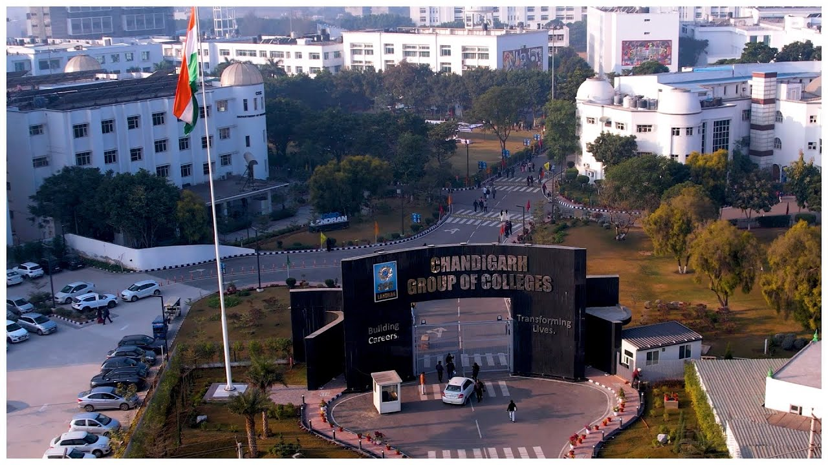

Slide 2
MISSION
The College Libraries are to sustain a physically and virtually appealing environment that promotes learning, teaching and research. It fosters lifelong intellectual growth and self-fulfilment by providing all users with versatile accessibility of the needed information resources. It also stimulates to promote individual sharing of ideas and love of reading and social enlightenment, enrichment throughout the knowledge society. It also supports in excellence and innovation in education and research.

Slide 3
OBJECTIVES
1) To establish a readers’ community to strengthen the goals.
2)To organize orientation programmes for users to keep them aware of the information society.
3) To promote the values and skills amongst the students.
4)To maintain a balanced and organized collection of high-quality materials and provide professional assistance to all users.
5) To provide access to information located elsewhere.
6)To educate users in developing information-gathering skills, including accessing, evaluating, and using various information sources.
7)To promote technological competence by providing access to information available in non-print formats.

Slide 4
CGC LIBRARIES
CEC-CGC COLLEGE | CCP COLLEGE | COE COLLEGE | CBSA COLLEGE | CCT COLLEGE | HOSPITALITY COLLEGE
MAIN LIBRARY | CCP LIBRARY | COE LIBRARY | CBSA LIBRARY | CCT LIBRARY | CCH LIBRARY
ECE DEPT. LIBRARY
IT DEPT. LIBRARY
CSE DEPT. LIBRARY
ET/ME DEPT. LIBRARY
APP. SC. DEPT. LIBRARY
11
LIBRARIES

Slide 5
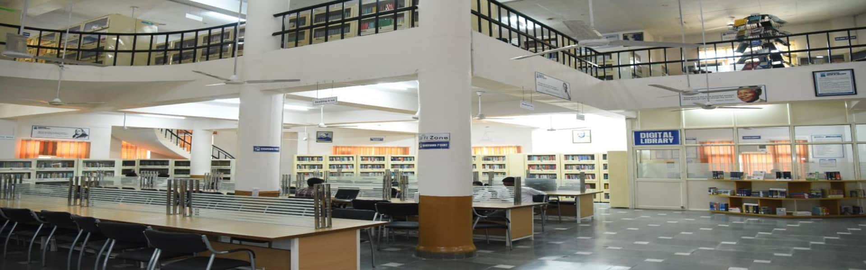
MAIN LIBRARY

Slide 6
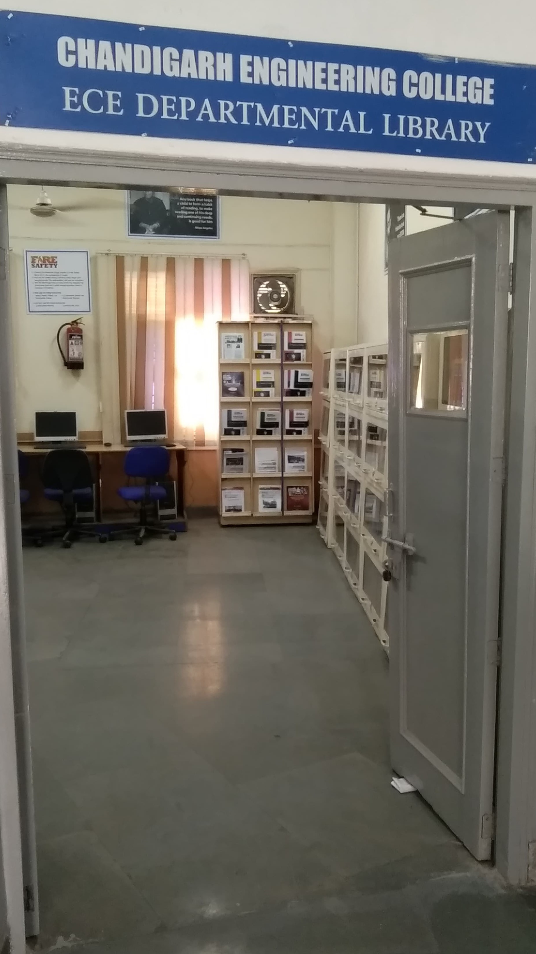
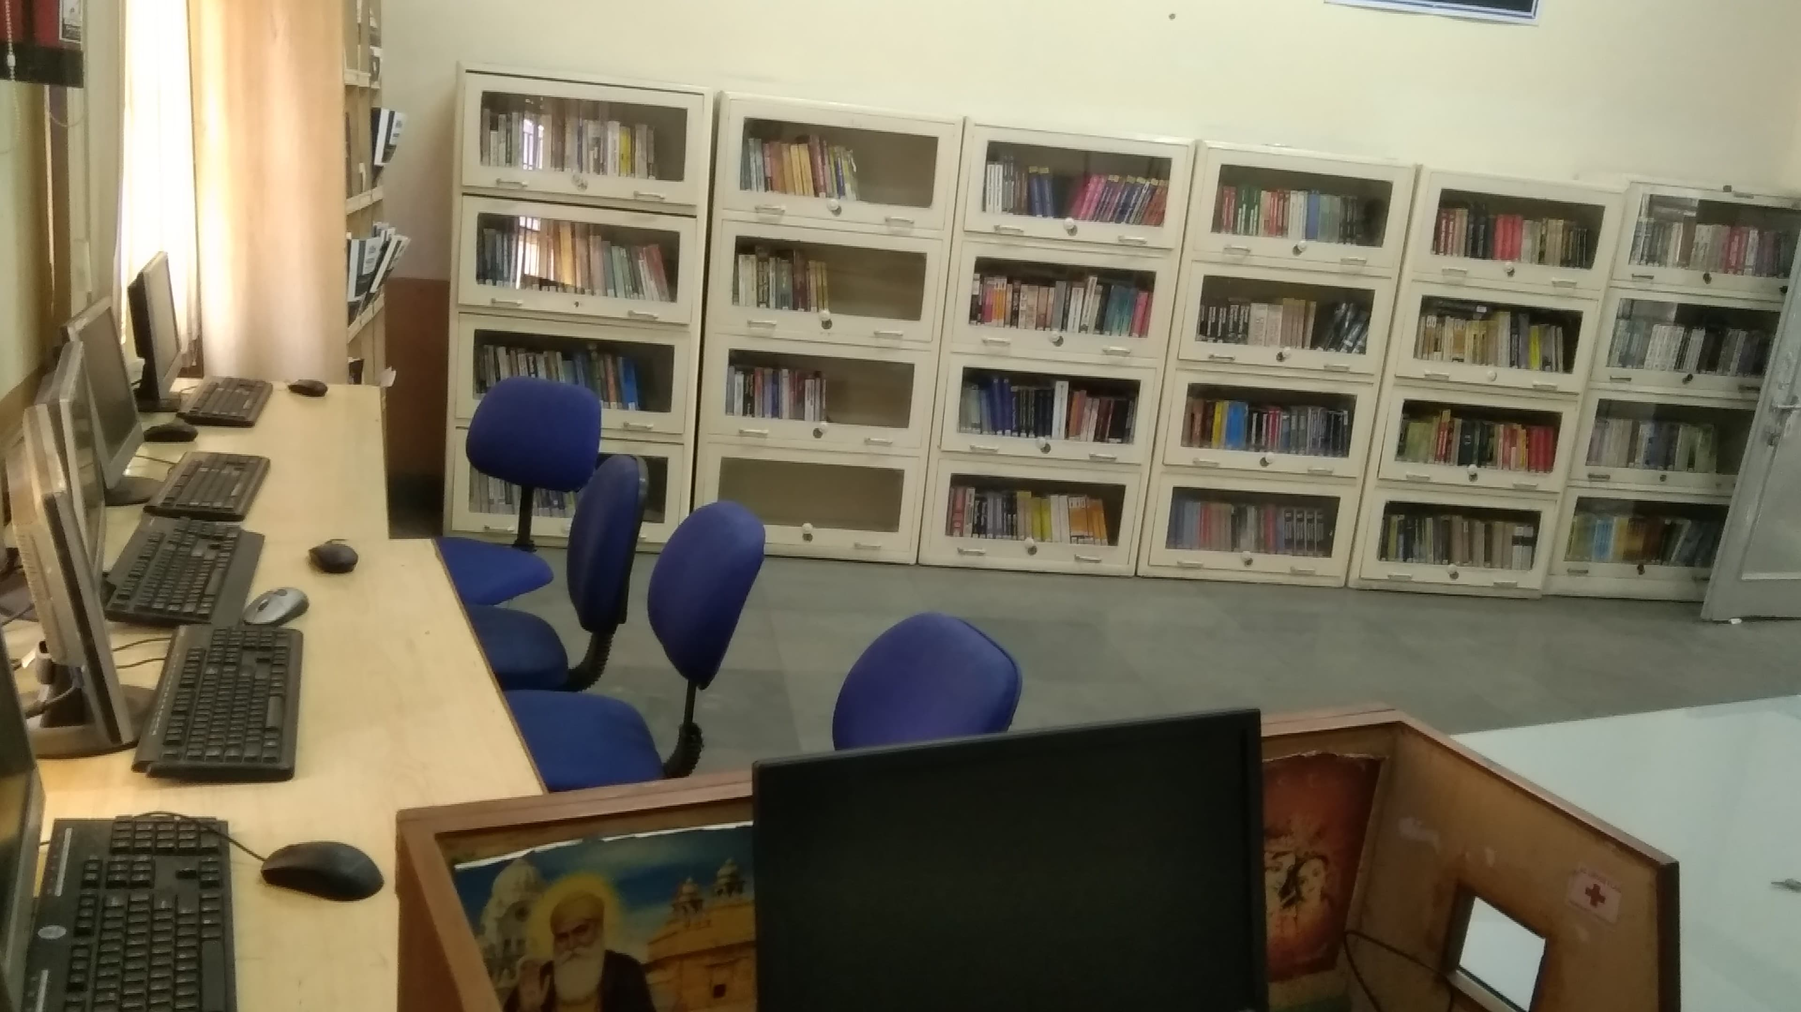
ECE DEPT. LIBRARY

Slide 7
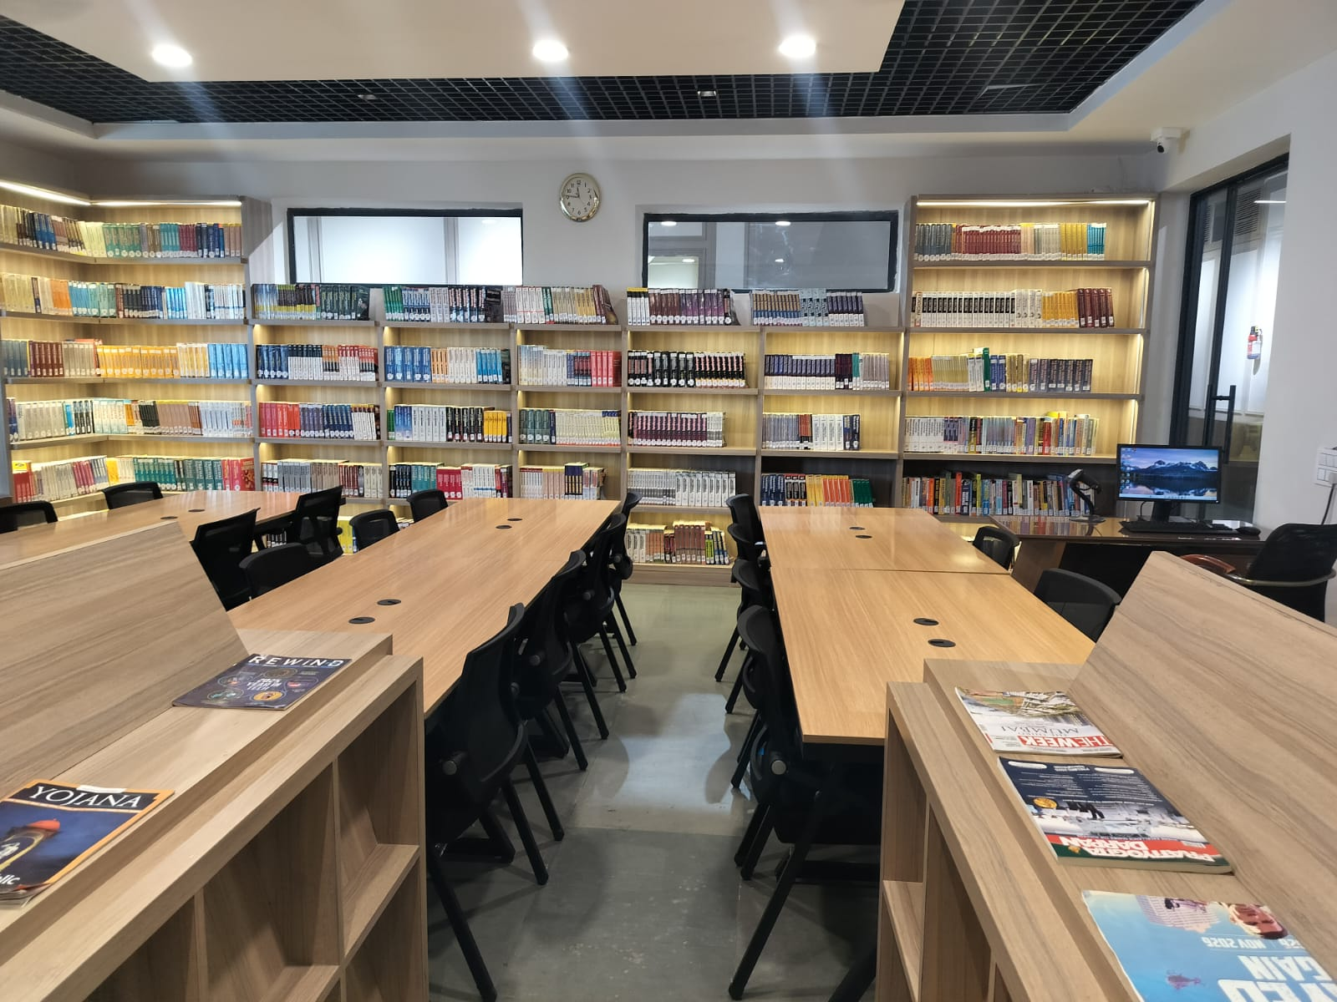
ET/ME DEPT. LIBRARY

Slide 8
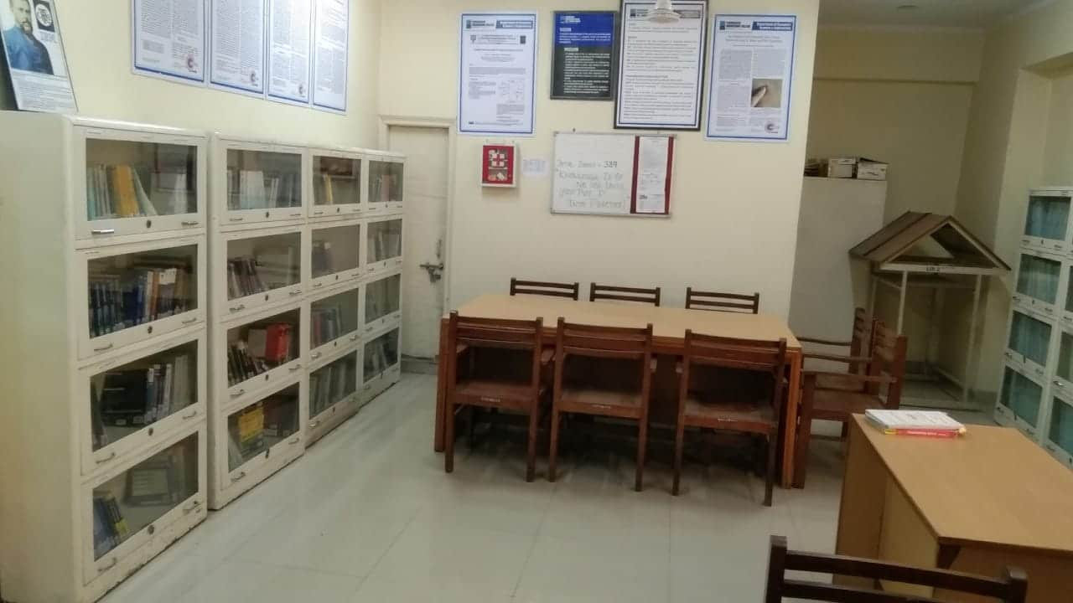
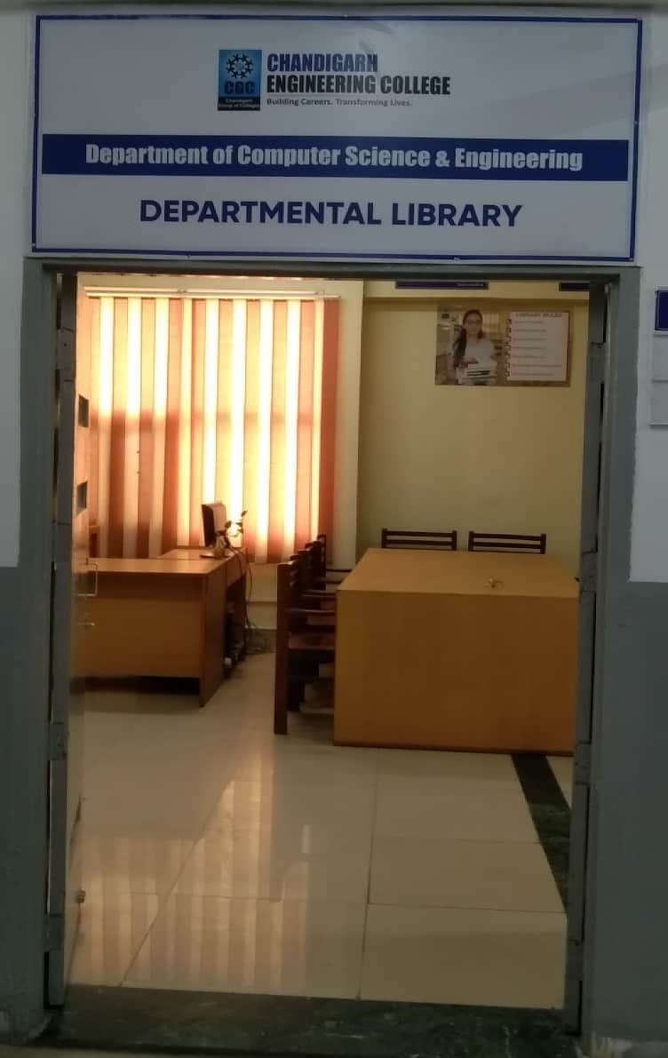
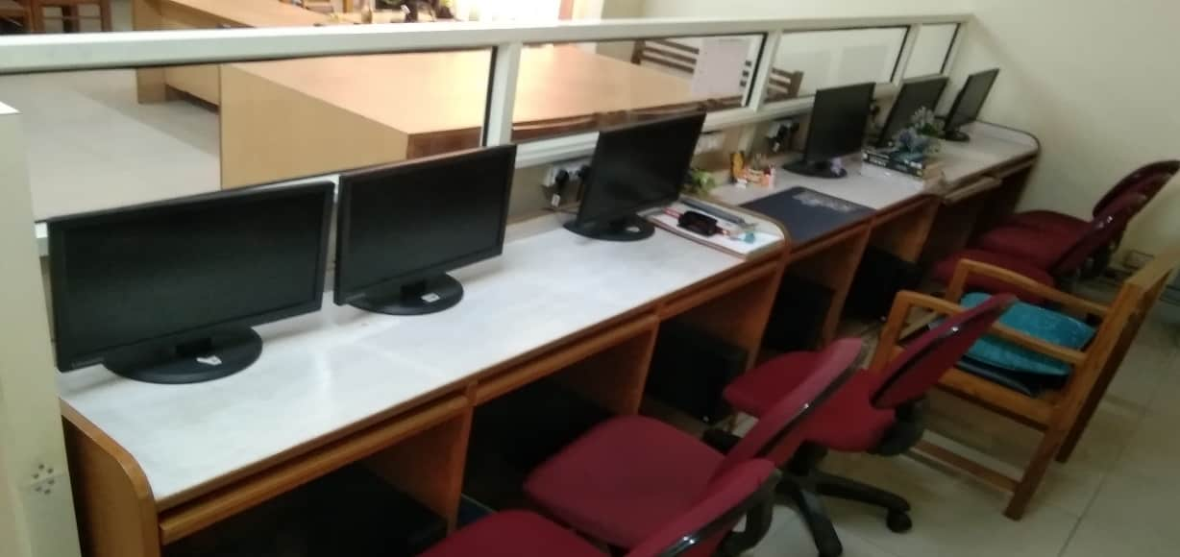
CSE DEPT. LIBRARY

Slide 9
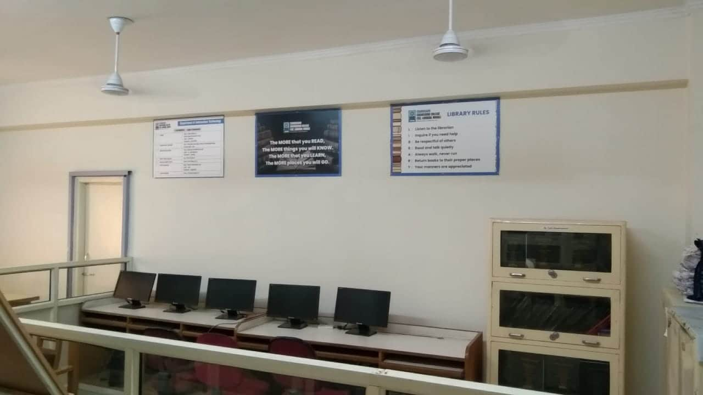
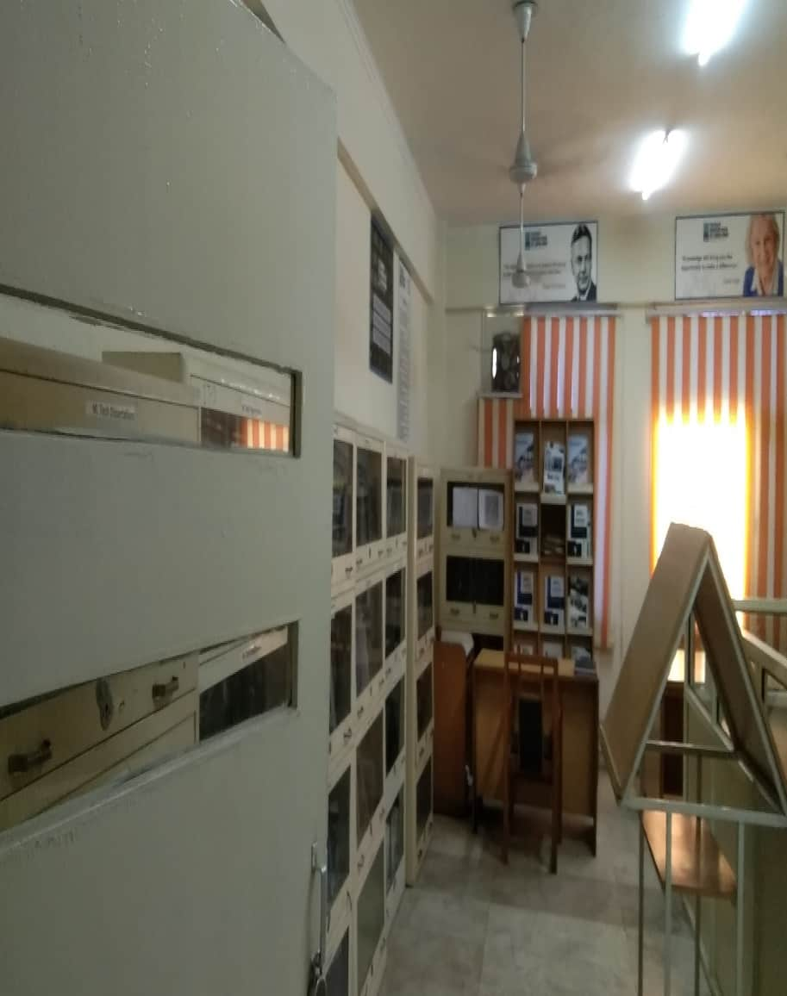
IT DEPT. LIBRARY

Slide 10
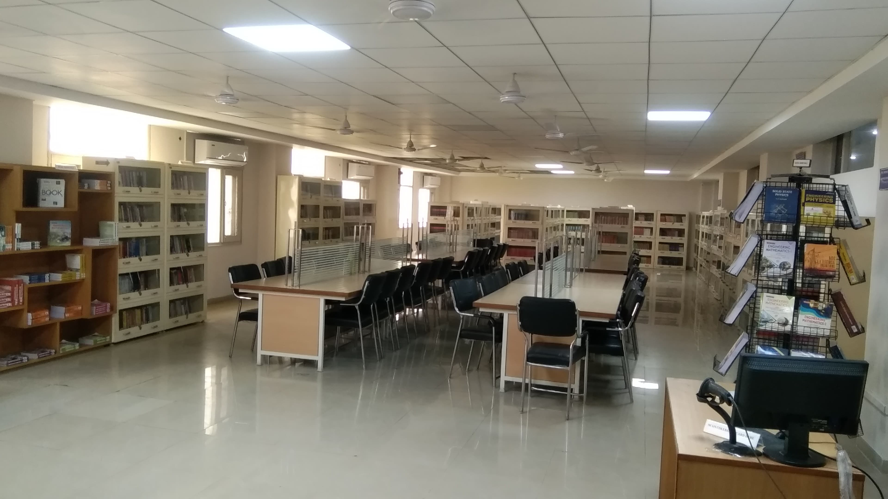
APP. SC. DEPT. LIBRARY

Slide 11
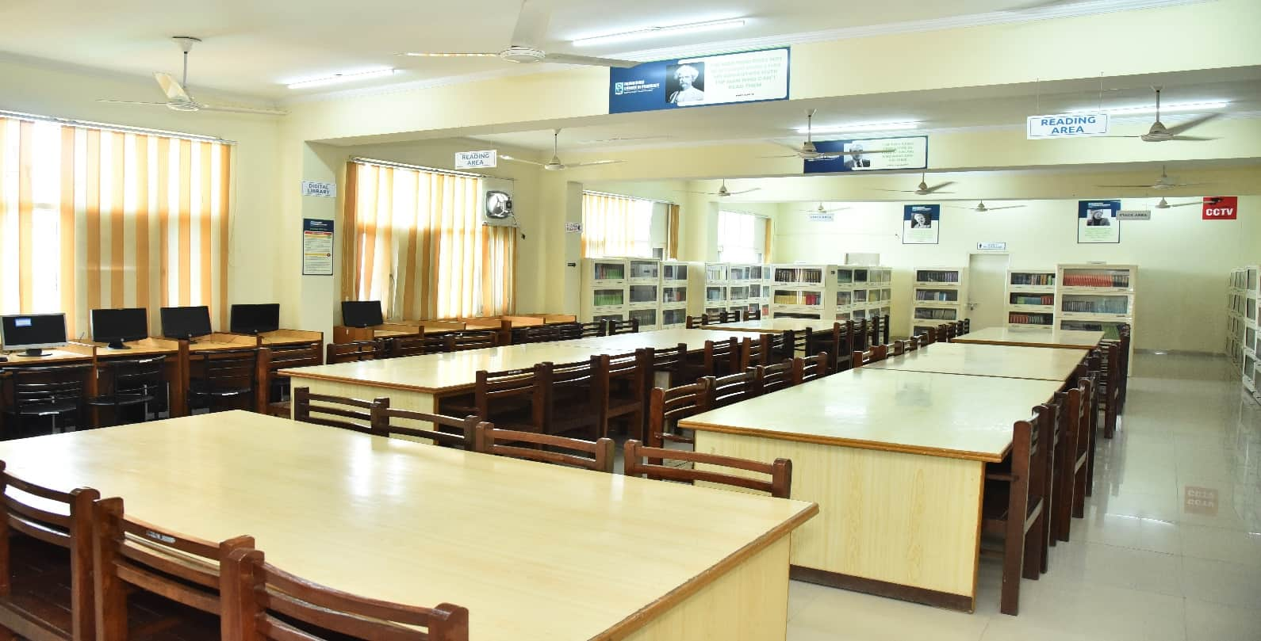
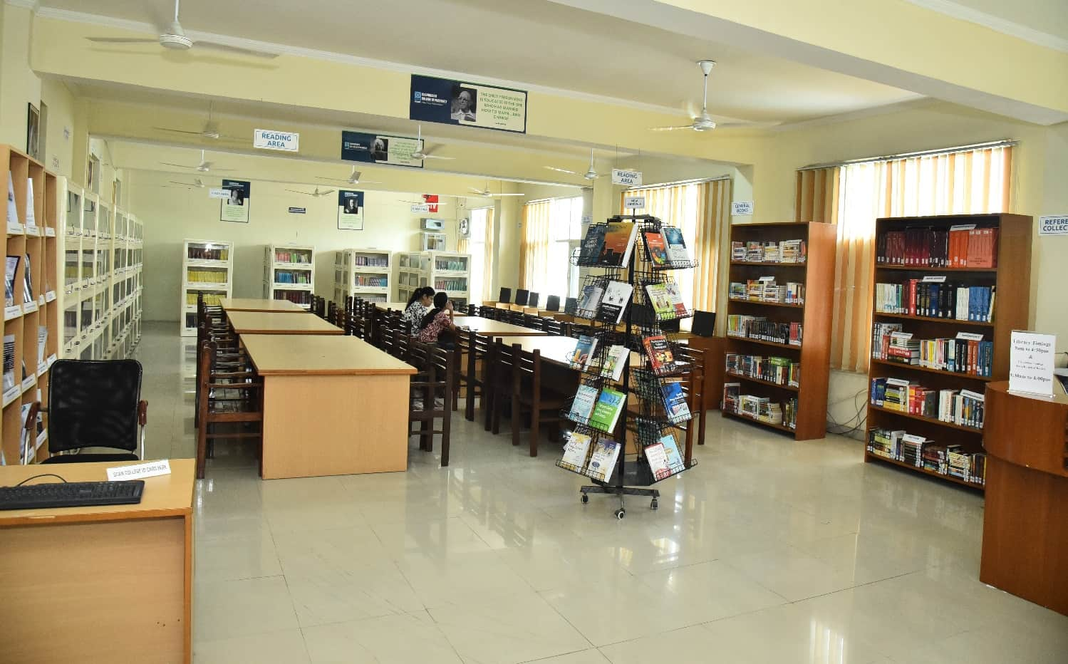
CCP LIBRARY

Slide 12
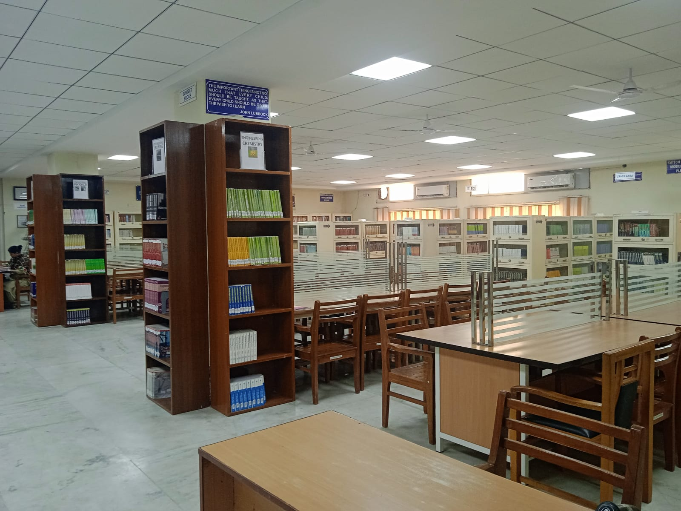
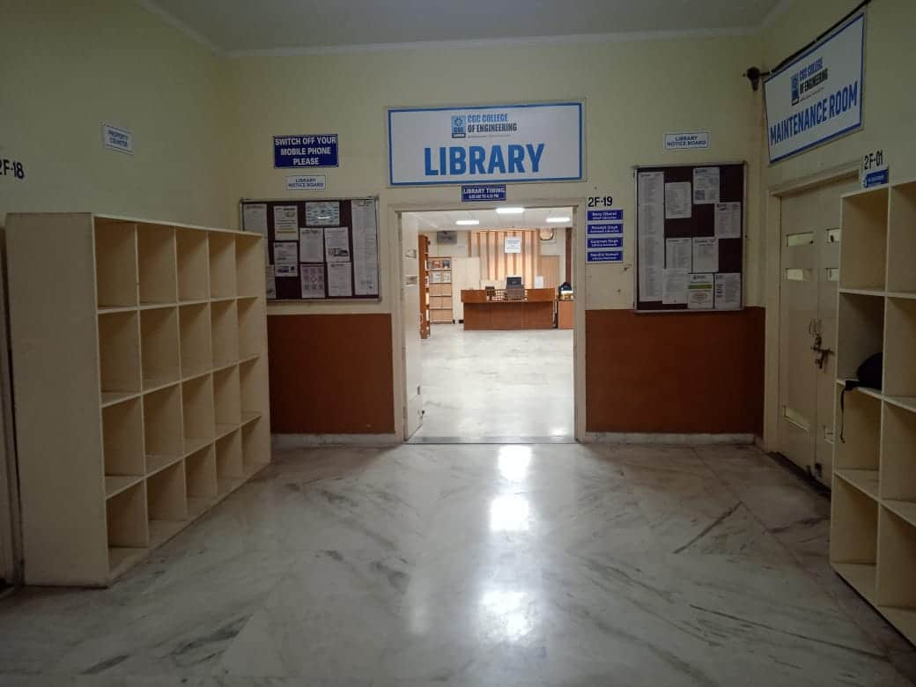
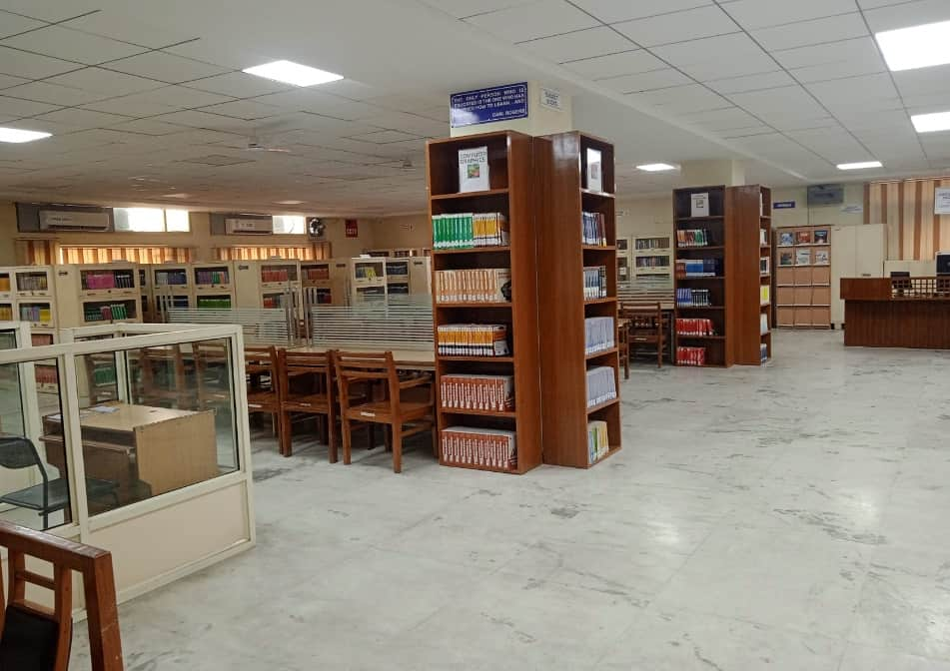
COE LIBRARY

Slide 13
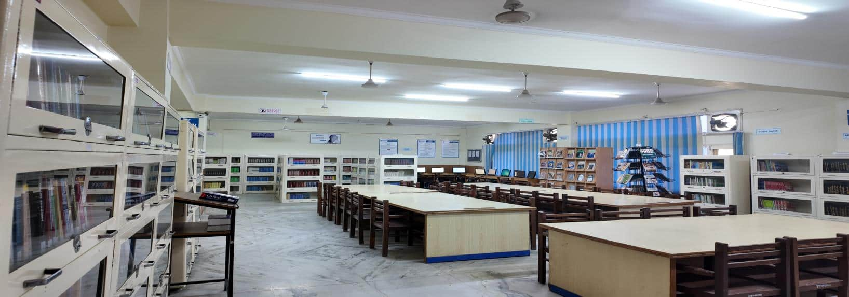
CBSA LIBRARY

Slide 14
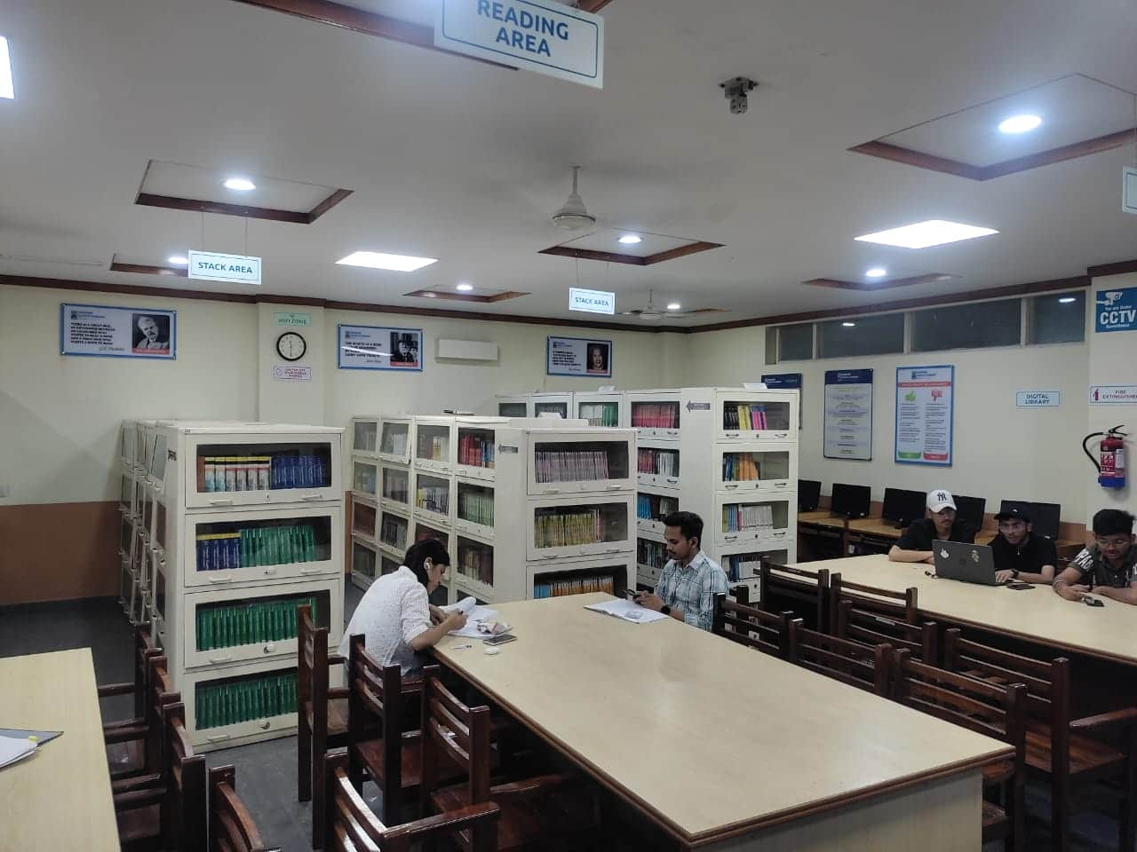
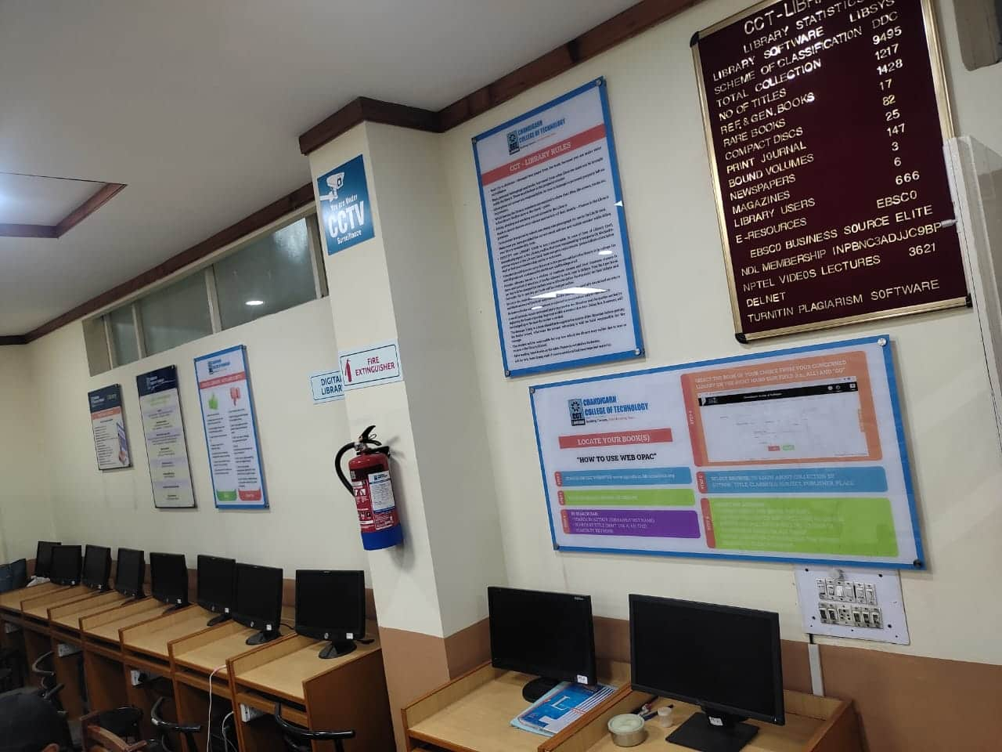
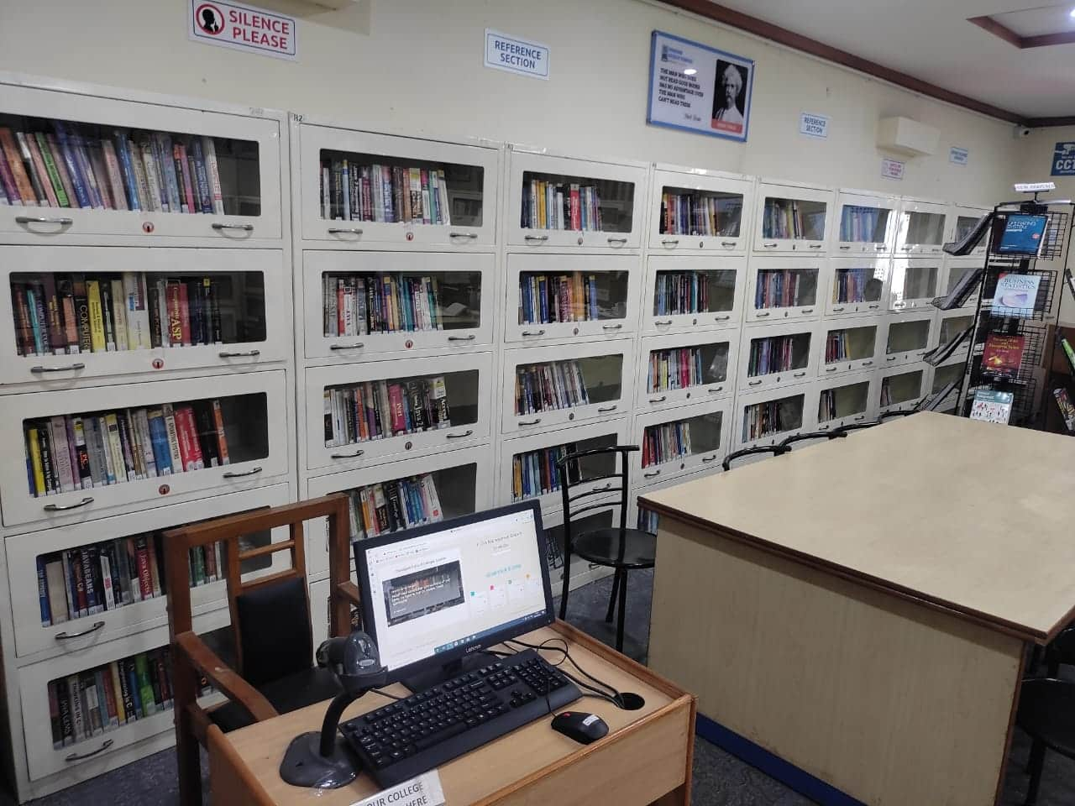
CCT LIBRARY

Slide 15
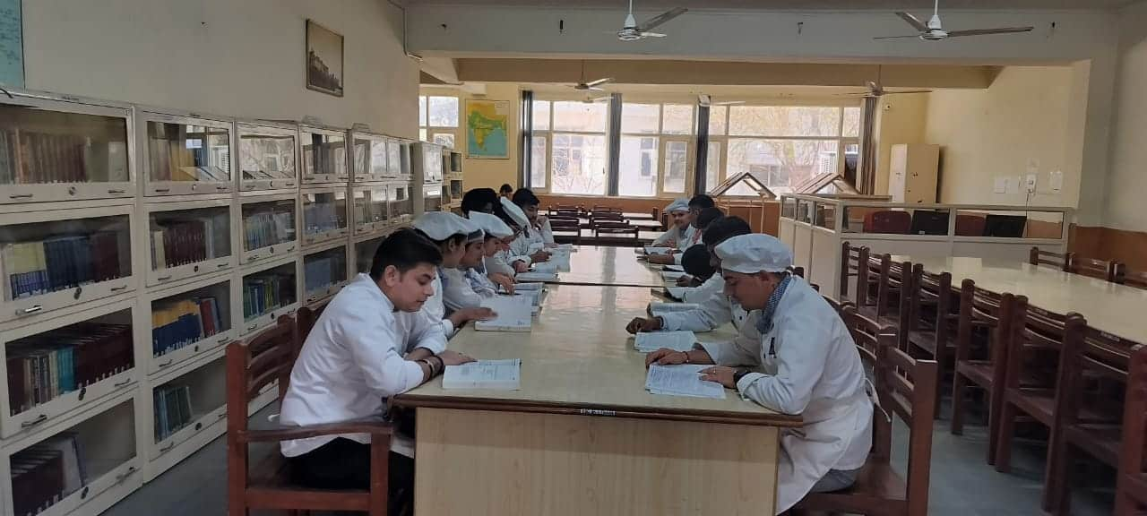
CCH LIBRARY

Slide 16
LIBRARIES AT A GLANCE
 | CEC | CBSA | COE | CCP | CCT | CCH | TOTAL
Volumes | 49062 | 21924 | 17660 | 13749 | 9909 | 10718 | 1,23,022
Titles | 9632 | 3641 | 1998 | 1707 | 1389 | 1805 | 20,172
Titles by Foreign Authors | 4135 | 1228 | 755 | 3060 | 549 | 673 | 10,400
Rare Books | 101 | 104 | 0 | 50 | 17 | 0 | 272
Ref. & Gen. Books | 2547 | 4212 | 2462 | 1862 | 1475 | 1905 | 14,463
Book Bank Collection | 956 | 249 | 0 | 0 | 0 | 325 | 1,530
Printed Journals | 64 |  |  | 15 | 5 | 5 | 89
Bound Volumes of Journals | 1199 | 419 | 135 | 187 | 147 | 37 | 2,124
Magazines | 21 |  |  |  |  |  | 21
Newspapers | 21 |  |  |  |  |  | 21
No. of CD’s & DVD’s | 1961 | 443 | 927 | 52 | 82 | 575 | 4,040

Slide 17
LIBRARY STATISTICS
TOTAL MEMBERSHIP
12240
1500
1250
DAILY FOOTFALL
DAILY TRANSACTIONS

Slide 18
CGC LIBRARY STAFF
CHIEF LIBRARIAN
RENU OBEROI
LIBRARIAN
3
ASSISTANT LIBRARIAN
7
LIBRARY ASSISTANT
7
LIBRARY RESTORER
8
ASSISTANT
1
PEON
2

Slide 19

COLLEGE WEBSITE http://cgc.edu.in/
LIBRARY SOFTWARE
LIBSYS

Slide 20
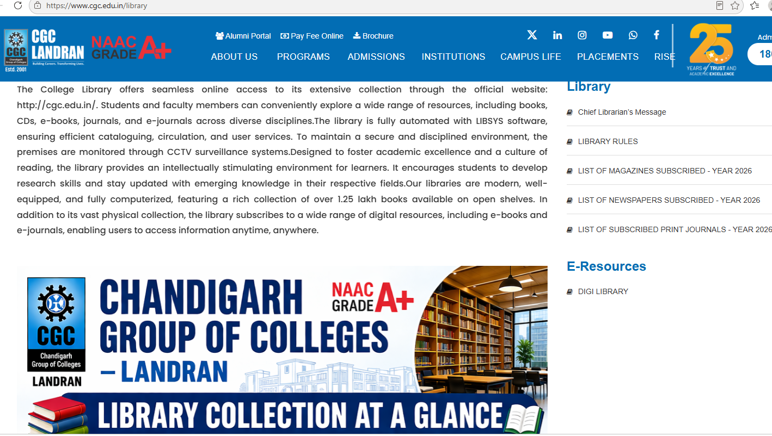
CGC WEBSITE
LIBRARY PAGE

Slide 21
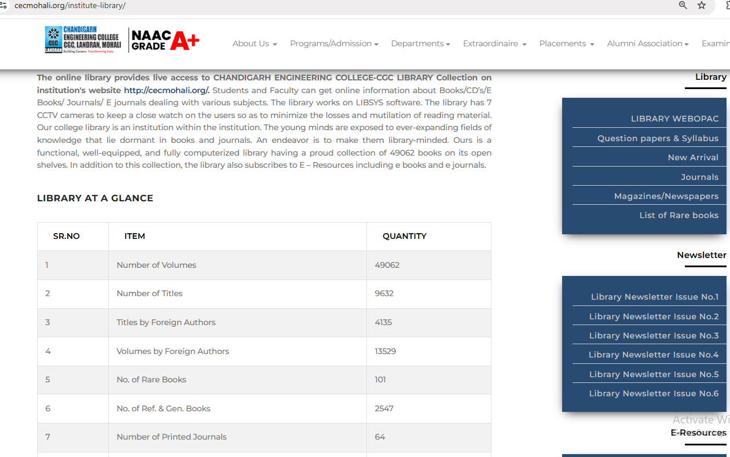
CEC COLLEGE WEBSITE
LIBRARY PAGE

Slide 22
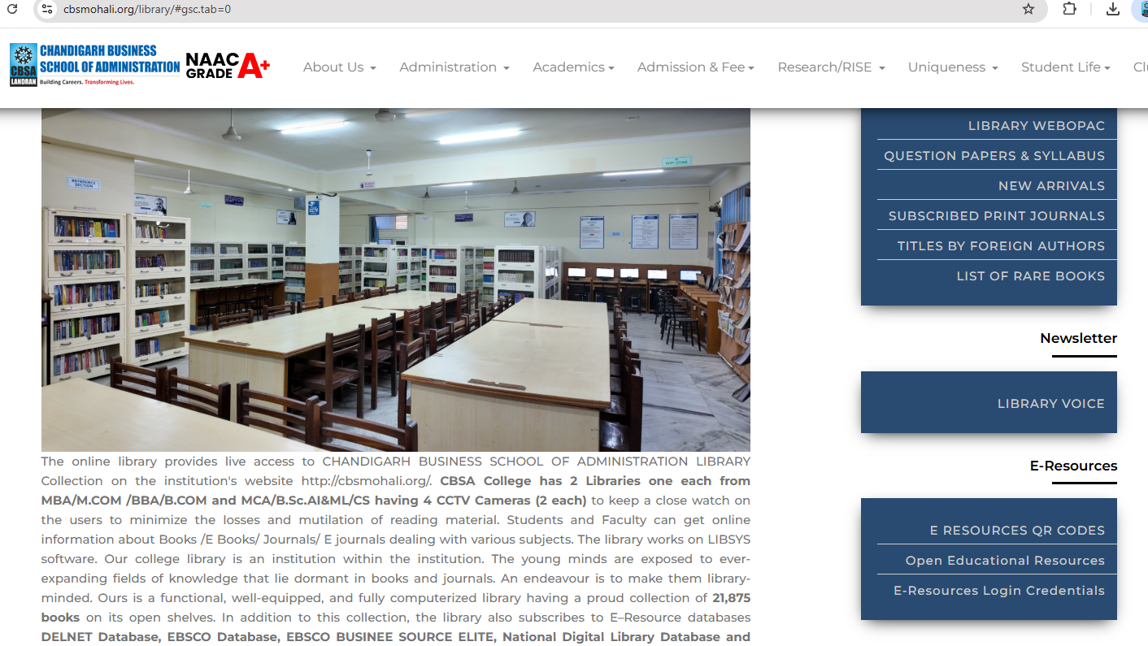
CBSA COLLEGE WEBSITE
LIBRARY PAGE

Slide 23
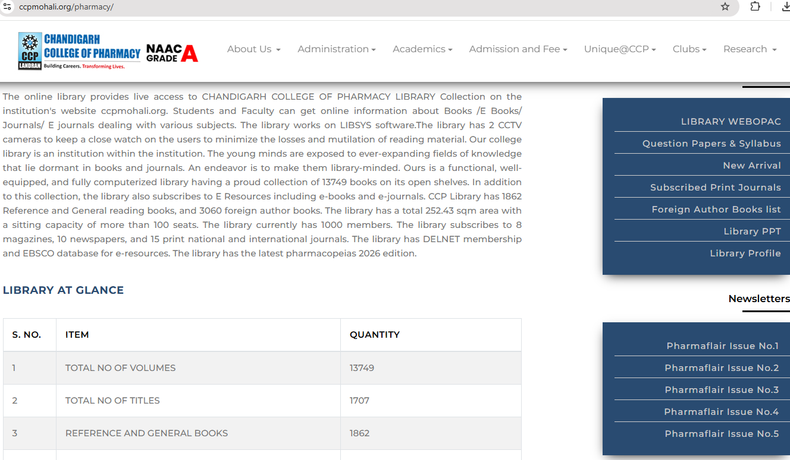
CCP COLLEGE WEBSITE
LIBRARY PAGE

Slide 24
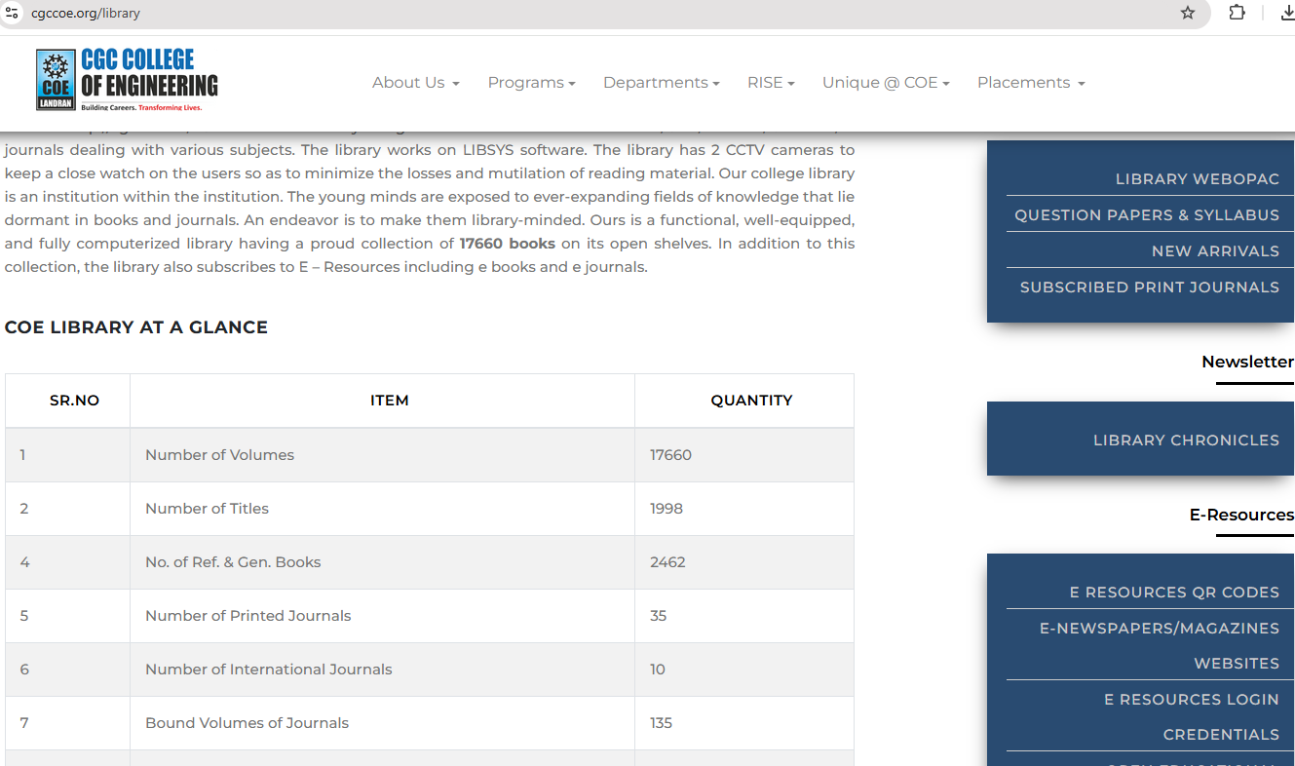
COE COLLEGE WEBSITE
LIBRARY PAGE

Slide 25
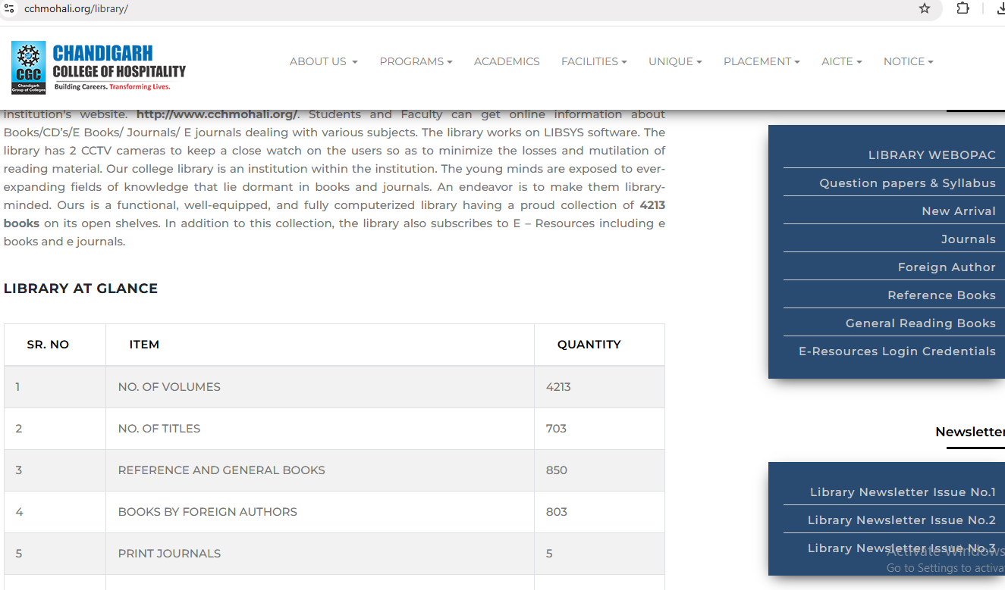
CCH COLLEGE WEBSITE
LIBRARY PAGE

Slide 26
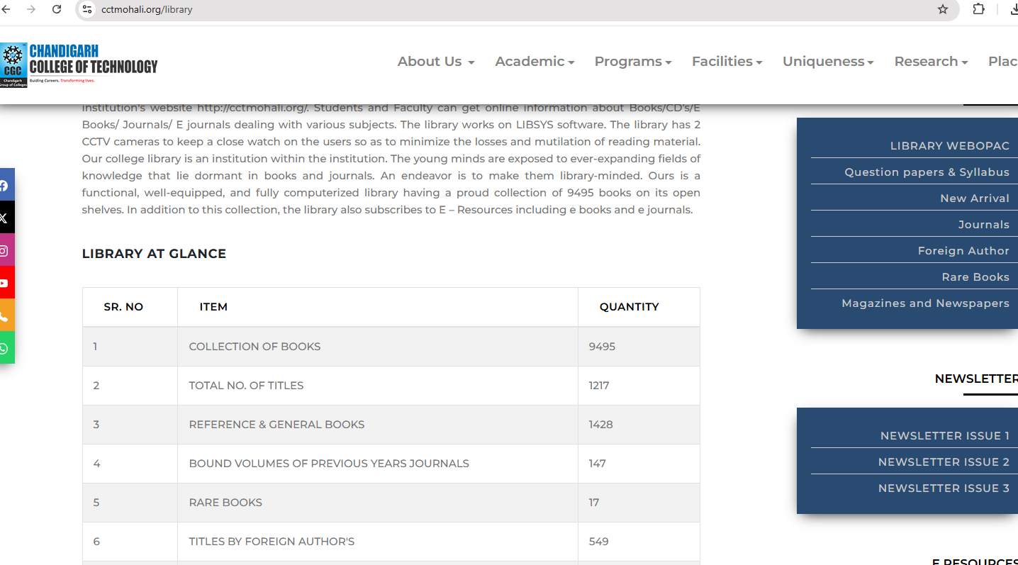
CCT COLLEGE WEBSITE
LIBRARY PAGE

Slide 27

LIBRARY NEWSLETTERS

Slide 28
SALIENT FEATURES OF LIBRARIES
1. LIBRARY COLLECTION INCLUDES REFERENCE BOOKS/ RARE BOOKS /COMPETITION BOOKS /GENERAL READING BOOKS and SUBJECT BOOKS
2. LIBRARY COLLECTION - CLASSIFIED AND BAR-CODED
3. SHELVING OF BOOKS IN CLASSIFIED ORDER AS PER DDC
4. COMPUTERIZED CIRCULATION
5. WEBOPAC - ON LIBRARY PREMISES AND REMOTE
6. E RESOURCES ACCESS - ON LIBRARY PREMISES AND REMOTE
7. AVAILABILITY OF OLD QUESTION PAPERS
8. PTU SYLLABI OF ALL CLASSES
9. REGULAR WEEDING OUT OLD EDITION/TORN/MUTILATED / OUT OF SYLLABUS BOOKS
10. REPROGRAPHIC AND SCANNING FACILITY
11. REPOSITORY OF PRESS CLIPPINGS SINCE 2001
12. BOOK BANK FACILITY
13. SCANNED LIBRARY ENTRY/EXIT
14. REGULAR DISPLAY OF NEW ARRIVALS

Slide 29
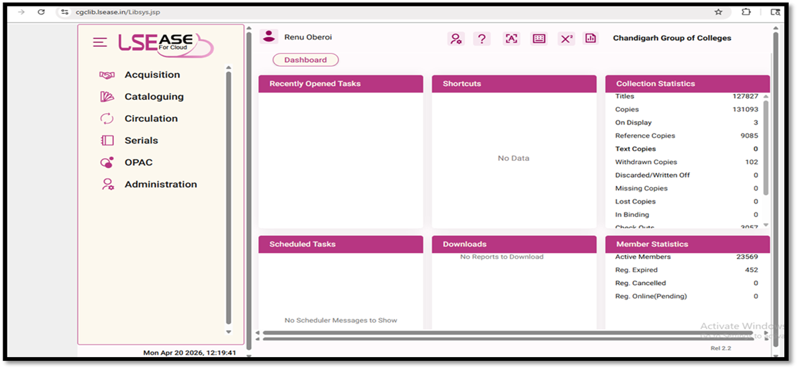
LIBRARY AUTOMATION USING INTEGRATED LIBRARY MANAGEMENT SYSTEM (ILMS)
LIBRARY SOFTWARE INTERFACE
Works on Cloud
URL : http://cgclib.lsease.in/
WEBOPAC with Remote Access
URL : http://cgcopac.lsease.in/

Slide 30
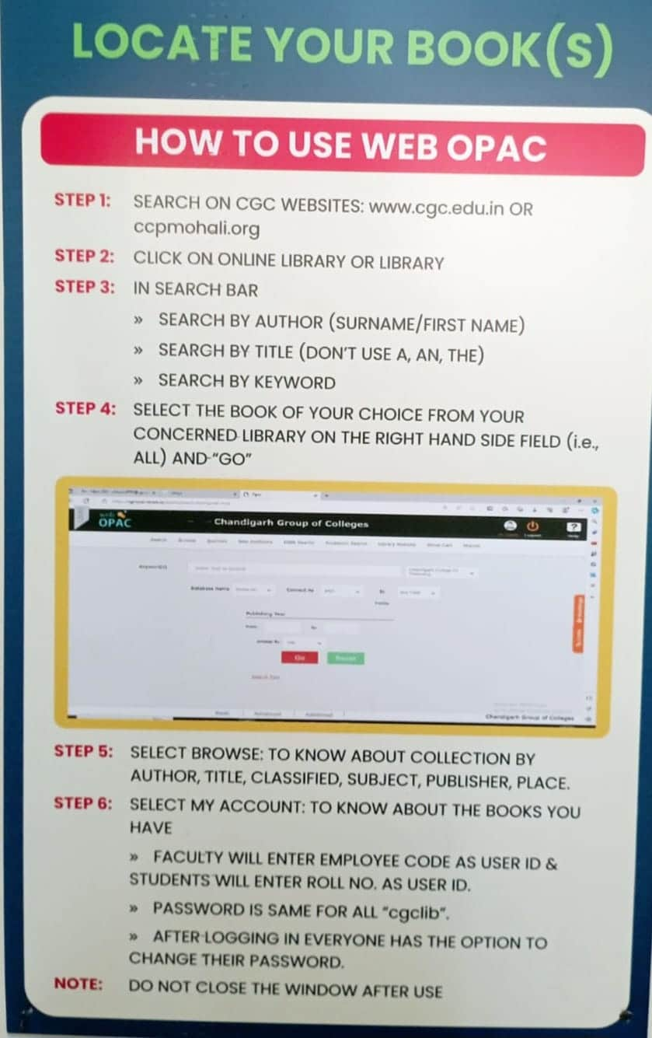
LIBRARY WEBOPAC

Slide 31


Slide 32

E RESOURCES
Number of e-books (WORLD E-BOOK LIBRARY) 20 Lacs+
Number of e-books (EBSCO) 2,65,000
NDL Membership E-BOOKs 45 Lacs+
Number of e-journals(DELNET) 4500+ e-journals(EBSCO) 5000+
Business Source Elite ( EBSCO) 1056 NPTEL VIDEO LECTURES 8000+
CDs ( of Books and Magazines) 4245
TURNITIN Plagiarism Software

Slide 33
DIGI LIBRARY
ANY TIME, ANY WHERE

Slide 34

The library has subscription of DELNET database via link http://www.delnet.in since the year 2013 and is subscribing e-journals and e-books through World e-book library via link http://database.worldlibrary.org/ and Gale journals via URL https://link.gale.com/apps/menu?u=chandigarhengg

Slide 35

EBSCO DATABASE
EBSCO resources can also be remotely accessed on EBSCO App. or on the link http://search.ebscohost.com.
It provides scholarly 5000 e-journals, working papers, reports, and datasets, and millions of digitized historical primary sources, including 2,65,000 e-books.

Slide 36
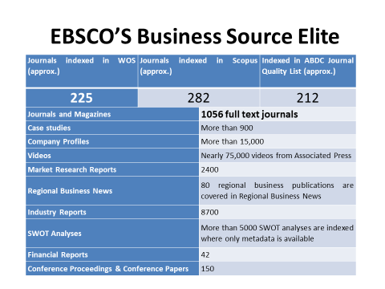

Slide 37

ANTI-PLAGIARISM SOFTWARE
To promote and support the research activities, CGC as a remedial measure has provided access to anti-plagiarism software TURNITIN since 2020.It is one such software, which is being successfully used at the global level to cross-check a vast database for identifying plagiarized portions in one’s research.

Slide 38

Lakhs of e-books can be accessed through NDL via link http://ndl.iitkgp.ac.in//.
INSTITUTIONAL NDL MEMBERSHIP NUMBER :INPBNC3ADJJC9BP

Slide 39

NPTEL Video lectures
Stream wise NPTEL
8000+ video lectures can be accessed via
FTP LINK - ftp://192.168.100.14

Slide 40
E-RESOURCES --- LOGIN CREDENTIALS
1. DELNET : http://www.delnet.in
Click to New Discovery Portal
Login : pbcecm
Password : cecm8478
2. WORLD LIBRARY ACCESS : http://database.worldlibrary.org/
Login : in_cgclm@user
Password : reading
3. DELNET-GALE E-JOURNALS : https://link.gale.com/apps/menu?u=chandigarhengg
Access code : info
4. EBSCO BUSINESS SOURCE ELITE : https://search.ebscohost.com/login.aspx?authtype=ip,uid&custid=ns154387&groupid=main&profile=ehost&defaultdb=bsh
User ID: chandigarhbusi
Password: Library@2025
5. EBSCO DATABASE : http://search.ebscohost.com
Login ID cgcl
Password clg@2022
6. EBSCO E-BOOKS ; https://assets.ebsco.com/m/2914c90c85e2c31b/original/EBSCO-eBooks-Academic-Collection-Title-List-Worldwide.xlsx
7. NPTEL VIDEO LECTURES : ftp://192.168.100.14
8. NATIONAL DIGITAL LIBRARY : https://ndl.iitkgp.ac.in/
9. TURNITIN PLAGIARISM SOFTWARE : https://www.turnitin.com/login_page.asp?lang=en_us
10. LIBSYS WEBOPAC : cgcopac.lsease.in

Slide 41

Repository Links
1 e-PG Pathshala https://epgp.inflibnet.ac.in
2 e-Shodh Sindhu https://ess.inflibnet.ac.in
3 Search Engine for PDF Books www.pdfdrive.com
4 National Digital Library of India https://ndl.iitkgp.ac.in
5 ShodhGanga https://shodhganga.inflibnet.ac.in/
6 Discover scientific knowledge and stay connected to the world of science https://www.researchgate.net/
7 Free e books(60000+)https://www.gutenberg.org/
8 NPTEL [National Programme on Technology Enhanced Learning] https://nptel.ac.in
9 NPTEL Video Lectures https://archive.nptel.ac.in/

Slide 42
10 OASIS (Openly Available Sources Integrated Search) https://openlibrary.org/
11 Open access for academic books https://www.oapen.org/
12 SAKSHAT https://sakshat.ac.in/?project=vidwan
13 Science, Health, Medical and Engineering Journals www.sciencedirect.com
14 Open Access books https://www.doabooks.org/
15 SWAYAMPRABHA https://www.swayamprabha.gov.in
16 SWAYAM Online Courses https://storage.googleapis.com/uniquecourses/online.html
17 Engineering Research papers Database www.engpaper.com
18 Engineering and Applied Sciences Technology Journals www.ijeast.com
19 Enhancement in Learning with Improvement in Skills (ELIS) portal http://free.aicte-india.org/
20 DOAB - Directory of Open Access Books https://directory.doabooks.org/handle/20.500.12854/34495

Slide 43
21 DOAJ https://doaj.org/
22 e-Content courseware in UG subjects http://cec.nic.in/cec/
23 E-Kalpa https://icar.org.in/content/e-kalpa
24 Open Access Books and Journals https://about.jstor.org/librarians/books/open-access-books-jstor/
25 Free e-Books https://www.gutenberg.org/
26 AICTE Collaborations (MoU) with other Organizations https://www.aicte-india.org/education/collaborations
27 AAKASH EDUCATIONAL PORTAL https://www.it.iitb.ac.in/nmeict/home.html
28 InfoPort https:/infoport.inflibnet.ac.in
29 National Educational Alliance for Technology https//neat.aicte-india.org/
30 OAPEN https://www.oapen.org/

Slide 44
31 QUANTUM & NANO COMPUTING https://www.dei.ac.in/dei/quantumNano/
32 The Online Books Page https://onlinebooks.library.upenn.edu/lists.html
33 SNLTR https://nltr.org
34 EThOS https://ethos.bl.uk/Home.do
35 DART-Europe E-theses Portal https://www.dart-europe.org/basic-search.php
36 Virtual Labs http://www.vlab.co.in/
37 YOUTH4WORK https://www.youth4work.com/onlinetalenttest
38 Theses https://library-archives.canada.ca/eng
39 Gateway Accelerating Scientific Discovery https://worldwidescience.org/
40 DIGITAL LIBRARY INFLIBNET https://ess.inflibnet.ac.in/

Slide 45
41 Digital Commons Network https://irsc.libguides.com
42 Engineering Journal Database researchgate.net
43 FOSSEE https://fossee.in
44 Study IQ Education www.youtube.com
45 UG/PG MOOC shttp://ugcmoocs.intlibnet.ac.in/ugemoocs
46 Engineering and technology Journal Database omicsonline.org
47 E-Books and E-Journalshttps://www.socsccybraryamu.ac.in/
48 CEC-UGC YouTube Channelhttps://www.youtube.com/user/cecedusat
49 TCS iON Digital Glass Room https://learning.tcsionhub.in/hub/glass-room/
50 RIChttps://eric.ed.gov/
51 Free e-Databaseshttp://www.globethics.net/

Slide 46

52 Free Journalshttp://www.archive.org
53 Spoken Tutorialhttps:/spoken-tutorial.org/
54 National Apprenticeship Training Scheme http://mhrdnats.gov.in/
55 E – Kumbh https://ekumbh.aicte-india.org/
56 E-BOOKS https://www.wikibooks.org/
57 Social Science Research Network (SSRN) https://www.ssrn.com/

Slide 47

e-Newspaper WEBSITES
http://www.tribuneindia.com/
www.indianpress.org
www.hindustantimes.com/
www.epaper.timesofindia.com
www.epaper.dailypostindia.com
https://epaper.thehindu.com
http://economictimes.indiatimes.com/
http://epaper.amarujala.com/
www.epaper.jagran.com/
http://epaper.bhaskar.com/
http://epaper.aajsamaaj.com/
http://epaper.punjabkesari.in/
http://jagbani.epapr.in/
http://epaper.ajitjalandhar.com/
http://www.rozanaspokesman.com/epaper/

Slide 48

FREE E-MAGAZINE WEBSITES https://freemagazinepdf.com/ https://worldmags.net/ https://fliphtml5.com/ https://www.bisinfotech.com/bisinfotech-magazine https://pdf-magazines.org/ https://all-freemagazines.com/ https://downmagaz.net/ https://www.pdfmagaz.club/ https://magazinenewsstand.com/digital-magazines https://pdf-magazines-download.com/

Slide 49

FACILITIES PROVIDED BY LIBRARY

Slide 50
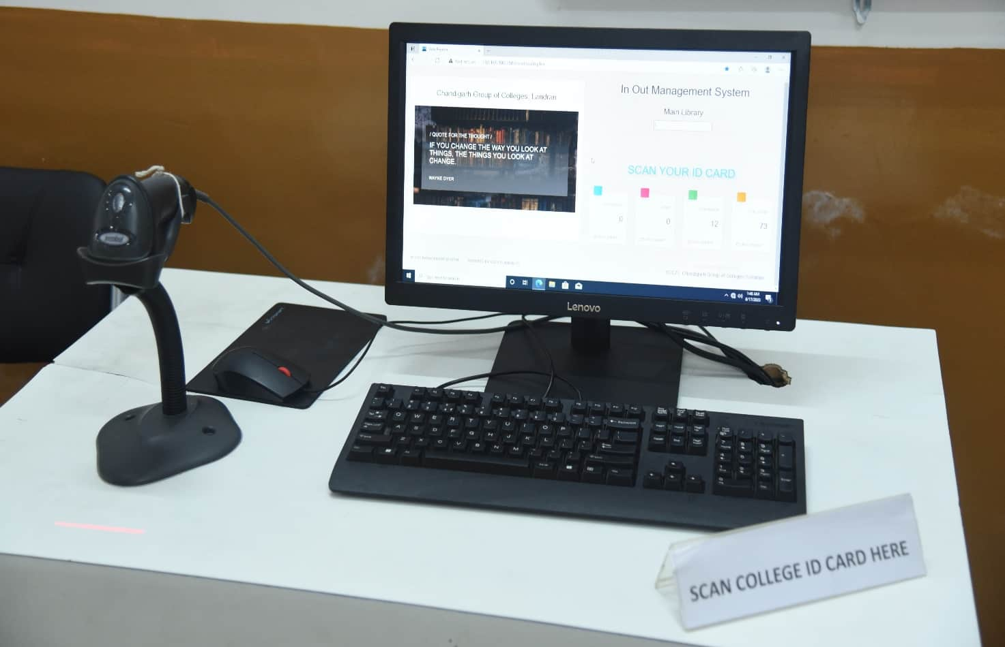
BARCODE SCANNED ENTRY/EXIT
Since the ID cards are scanned to keep track of entry and exit, foot traffic in the library is computerized. Students scan their ID cards as they enter or leave the library using the barcode scanner for that.

Slide 51
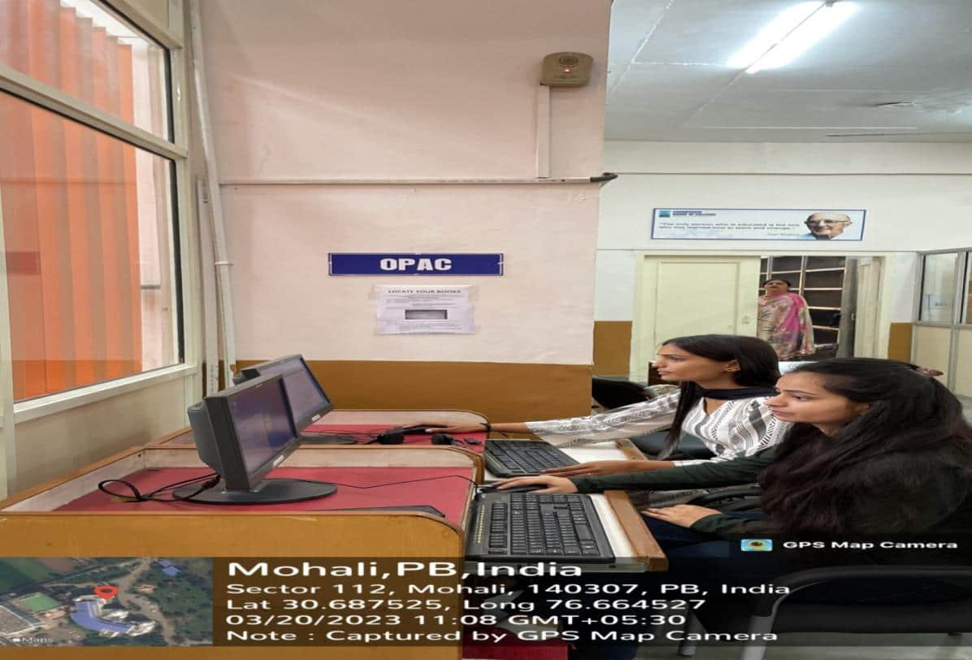
ONLINE CATALOGUE (OPAC)
The facility to search the open public access catalogue (OPAC) is open to all the users over the campus-wide LAN at the URL: https://cgcopac.lsease.in/. 1 pc in each library is exclusively dedicated to OPAC search to facilitate the users.

Slide 52
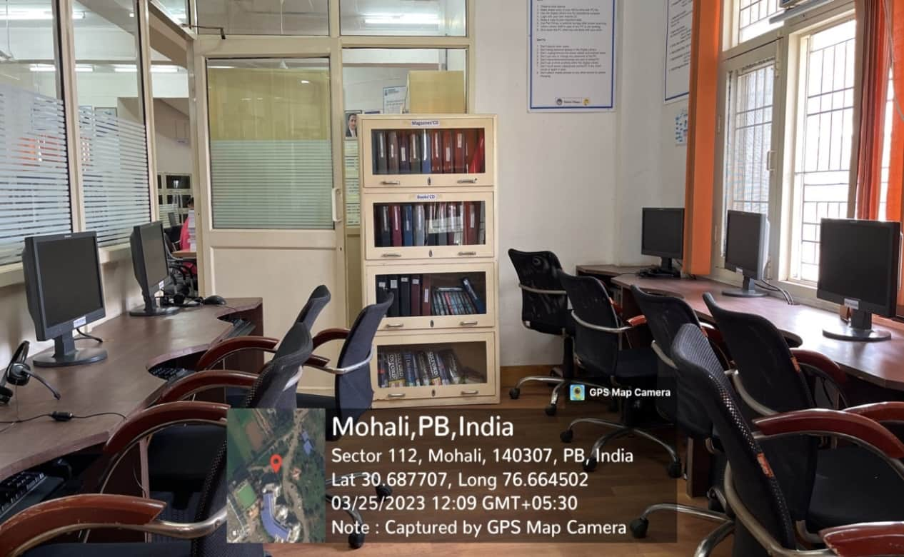
DIGITAL LIBRARY
THE LIBRARIES INTENDS TO HAVE A WELL-DEVELOPED COMPUTER AND NETWORK INFRASTRUCTURE IN THE FORM OF A DIGITAL LIBRARY WITH A PROVISION OF 10 COMPUTERS IN EACH LIBRARY TO FACILITATE THE USE OF ALL THE WEB-BASED RESOURCES AND SERVICES SUBSCRIBED

Slide 53
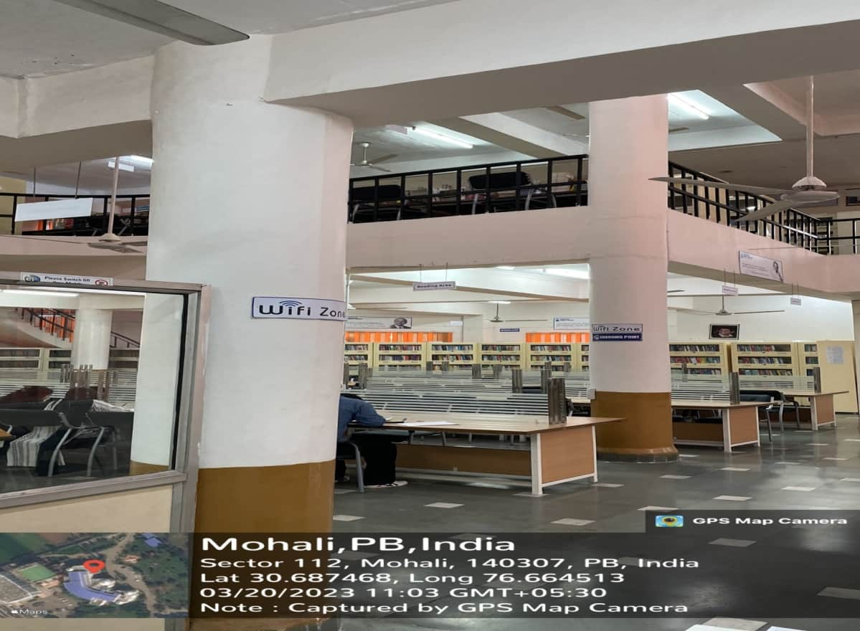
WI-FI FACILITY
STUDENTS & FACULTY CAN ACCESS THE INTERNET WITHIN LIBRARY PREMISES ON THEIR LAPTOPS AND MOBILES AS THE LIBRARIES ARE WI-FI ENABLED.

Slide 54
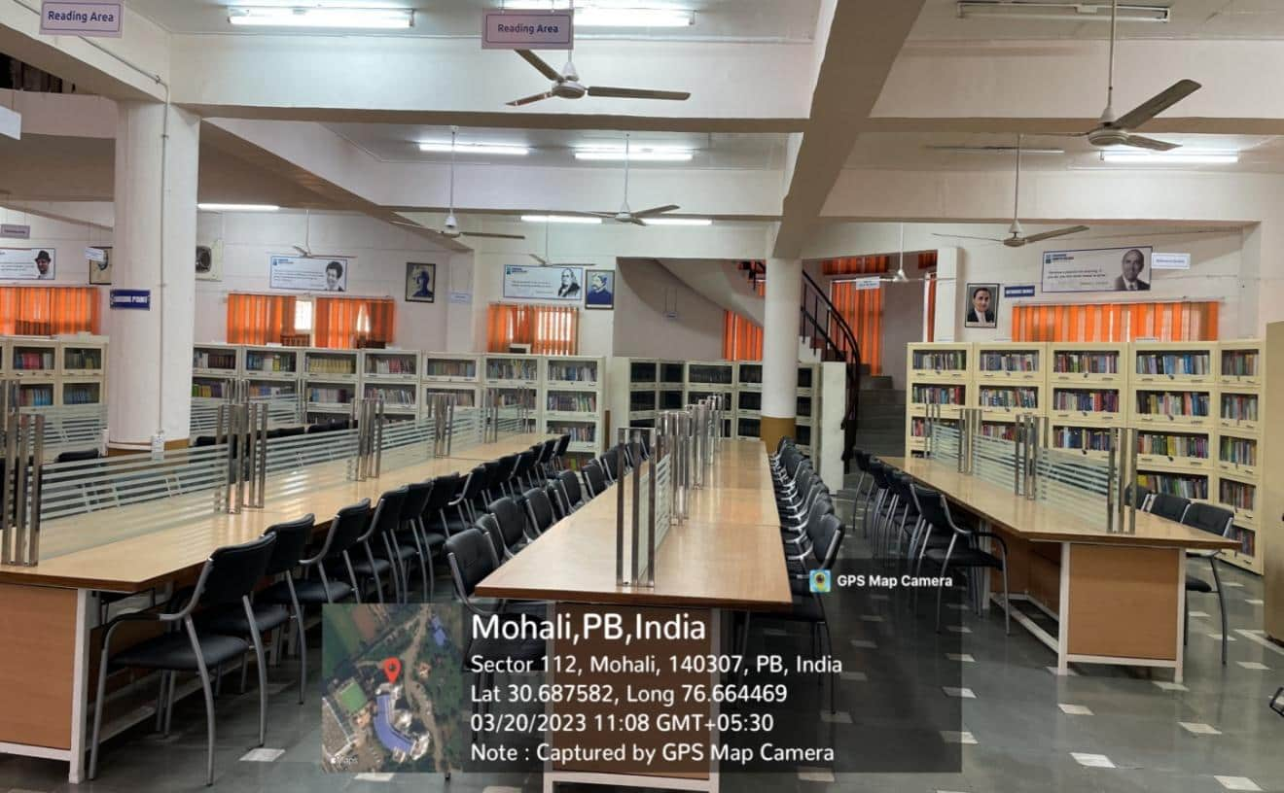
READING HALL FACILITY
The libraries provides its users with a conducive atmosphere with ample seating capacity.

Slide 55
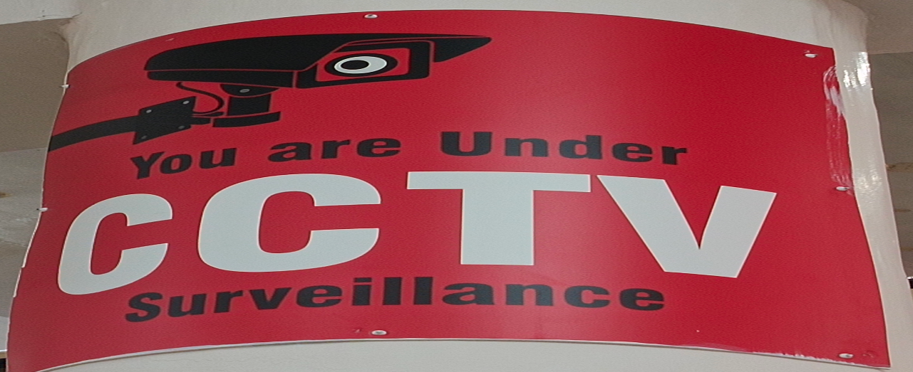
CCTVs in Library
CCTVs are installed in ALL LibrarIES for 24hr. Surveillance

Slide 56
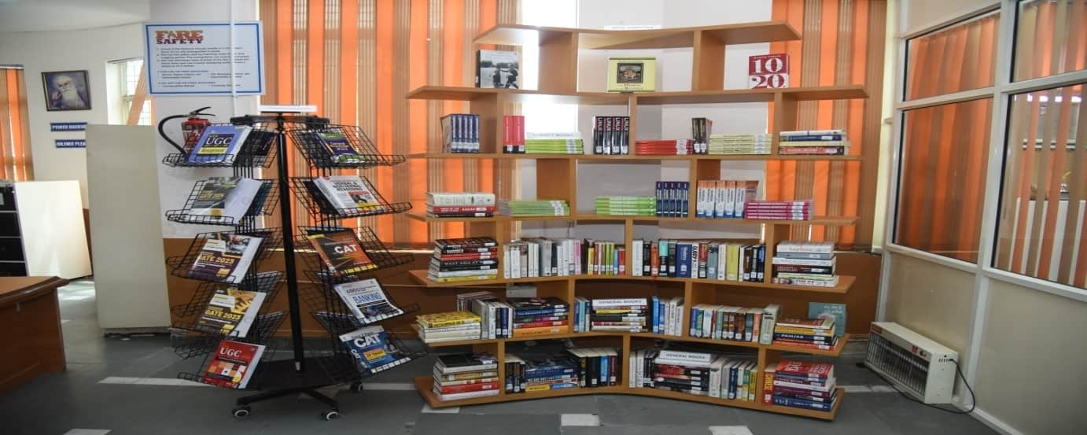
DISPLAY OF NEW ARRIVALS

Slide 57

DIFFERENT SECTIONS OF LIBRARY
ENTRY/EXIT GATE
PROPERTY COUNTER
WEBOPAC SECTION
ACQUISITION SECTION
TECHNICAL SECTION
REFERENCE SECTION
RARE BOOK SECTION
CIRCULATION SECTION
PG COURSES SECTION
PERIODICAL SECTION
BOUND VOLUMES SECTION
BOOK BANK SECTION
DIGITAL LIBRARY SECTION
REPROGRAPHIC SECTION

Slide 58
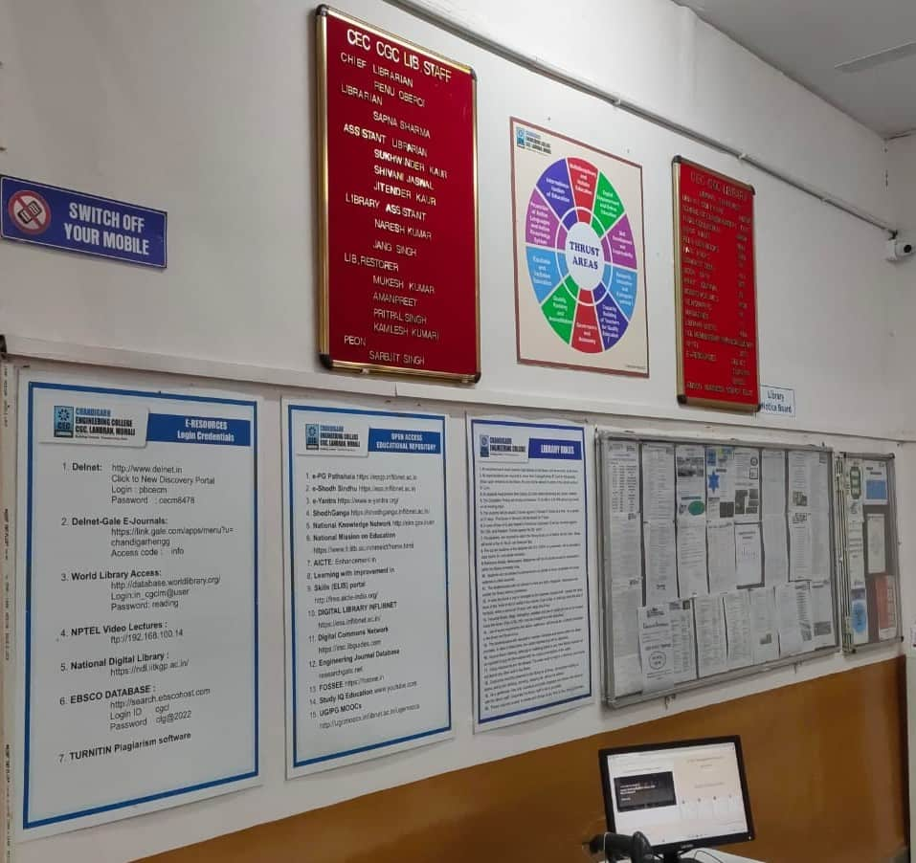
LIBRARY NOTICE BOARD

Slide 59
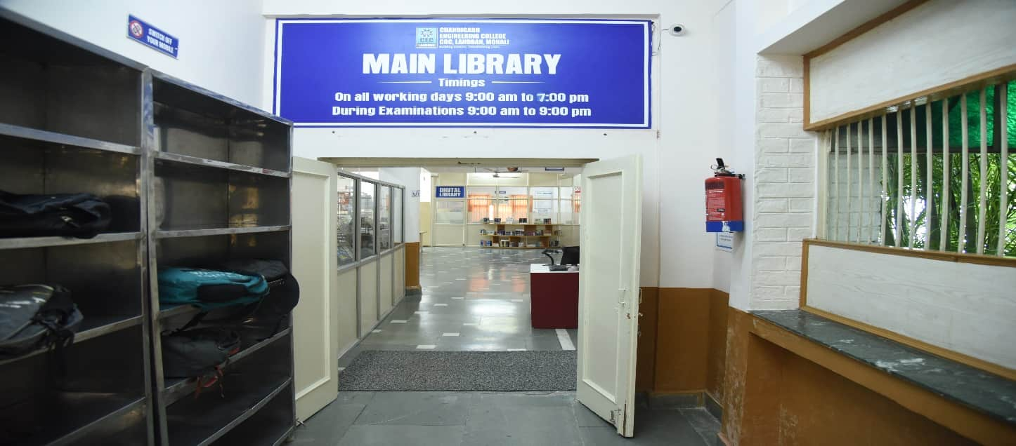
ENTRY / EXIT GATE

Slide 60
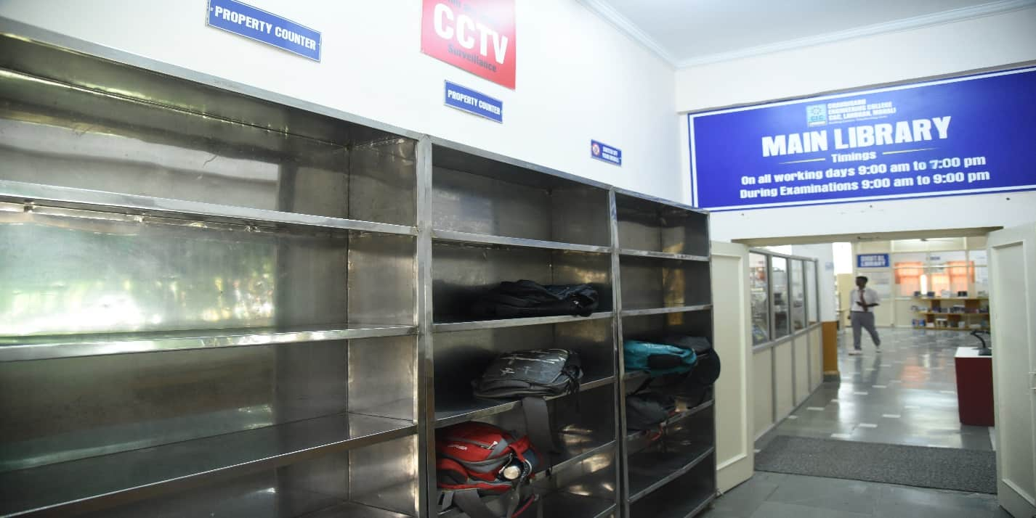
PROPERTY COUNTER

Slide 61
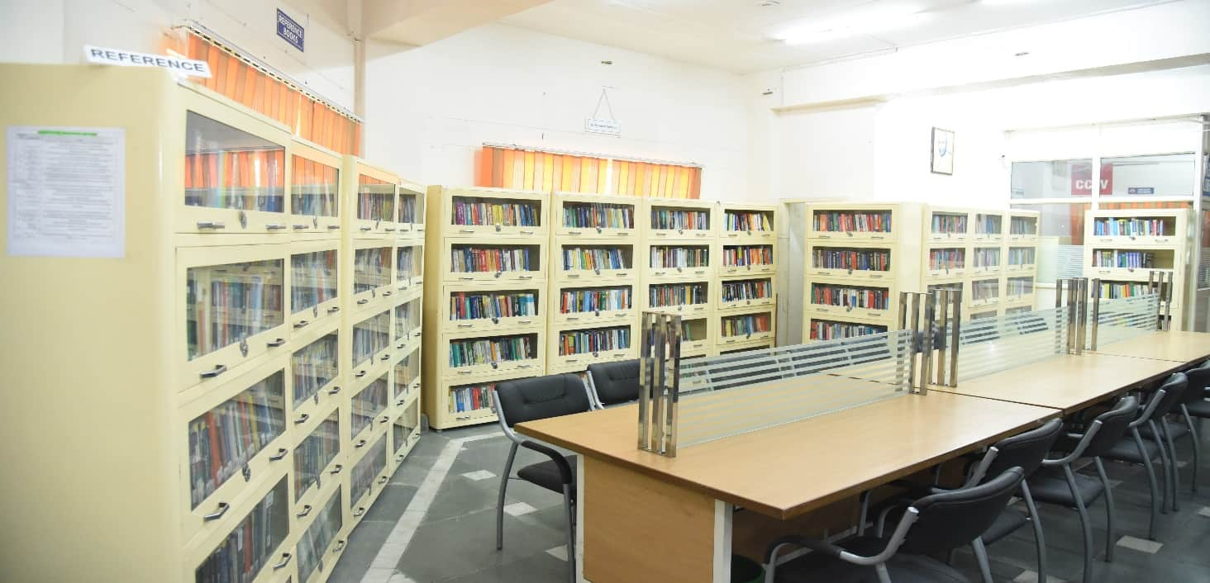
REFERENCE SECTION

Slide 62
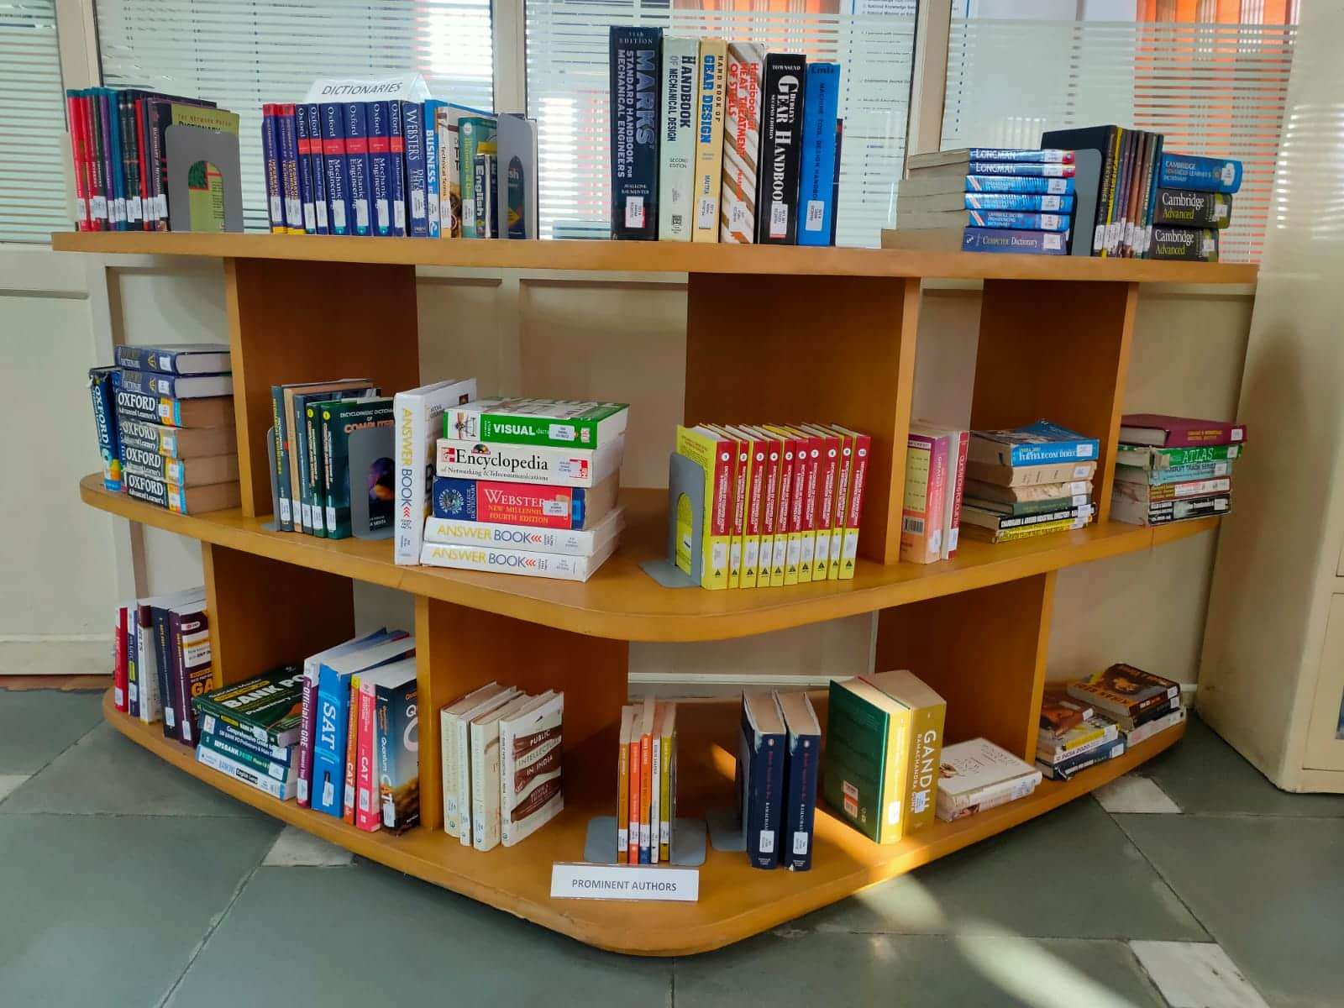
DISPLAY OF ENCYCLOPEDIA/ DICTIONARIES

Slide 63
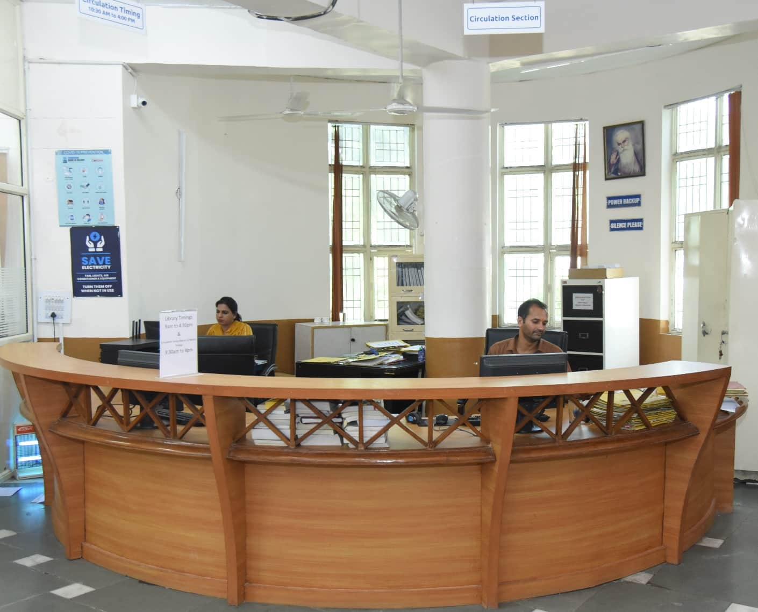
CIRCULATION SECTION

Slide 64
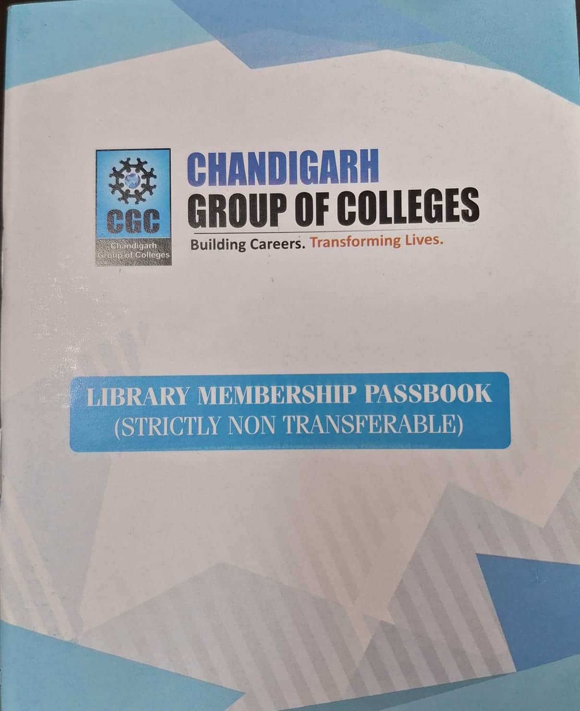
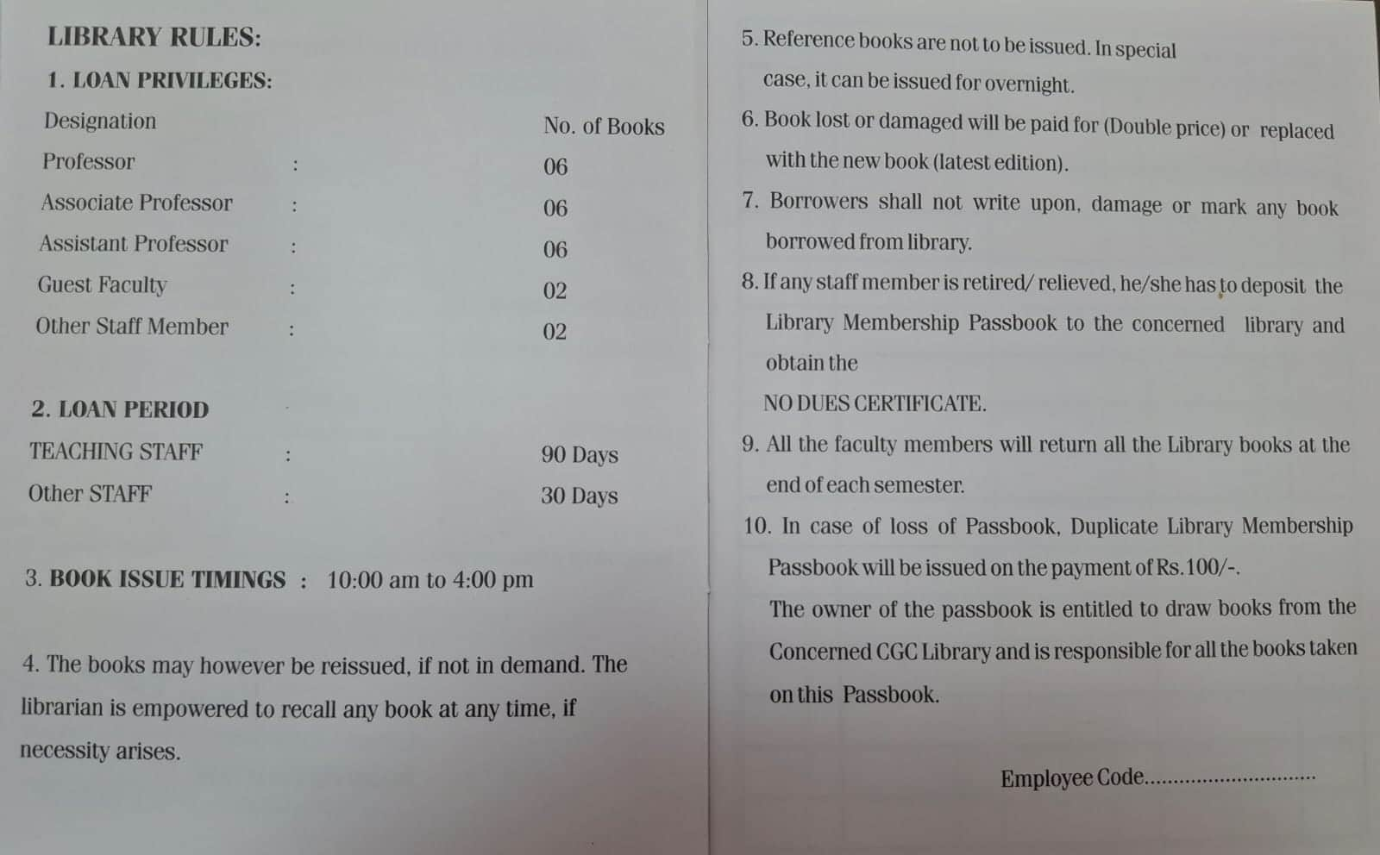
SPECIMEN : FACULTY
LIBRARY MEMBERSHIP PASSBOOK

Slide 65
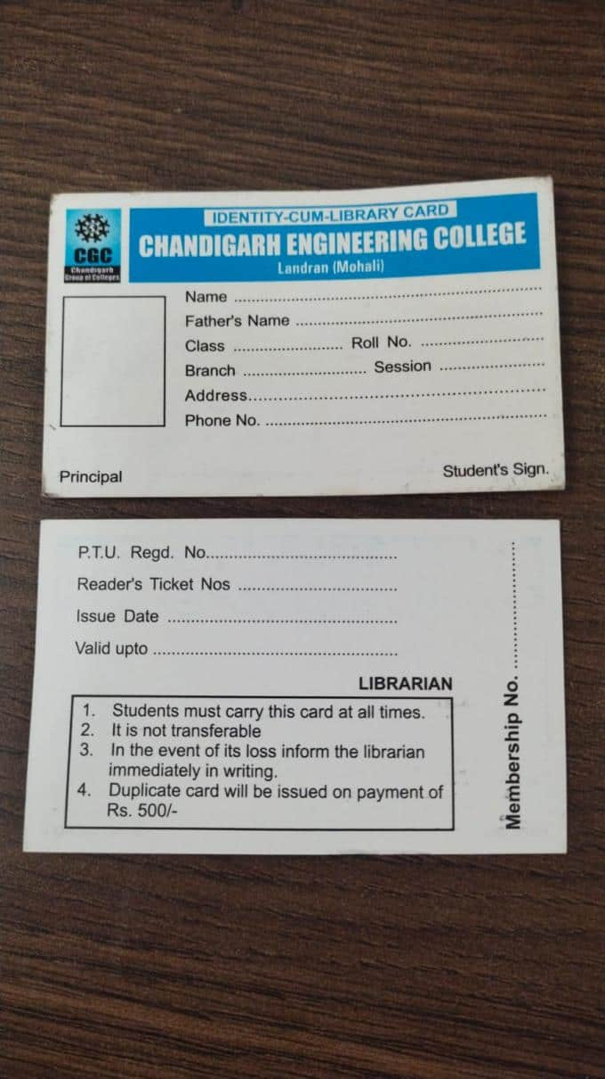
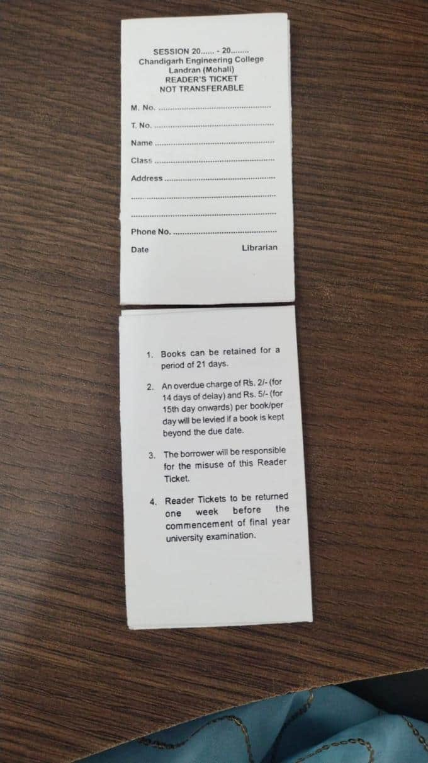
SPECIMEN : STUDENTS’ LIBRARY CARD AND TICKETS

Slide 66
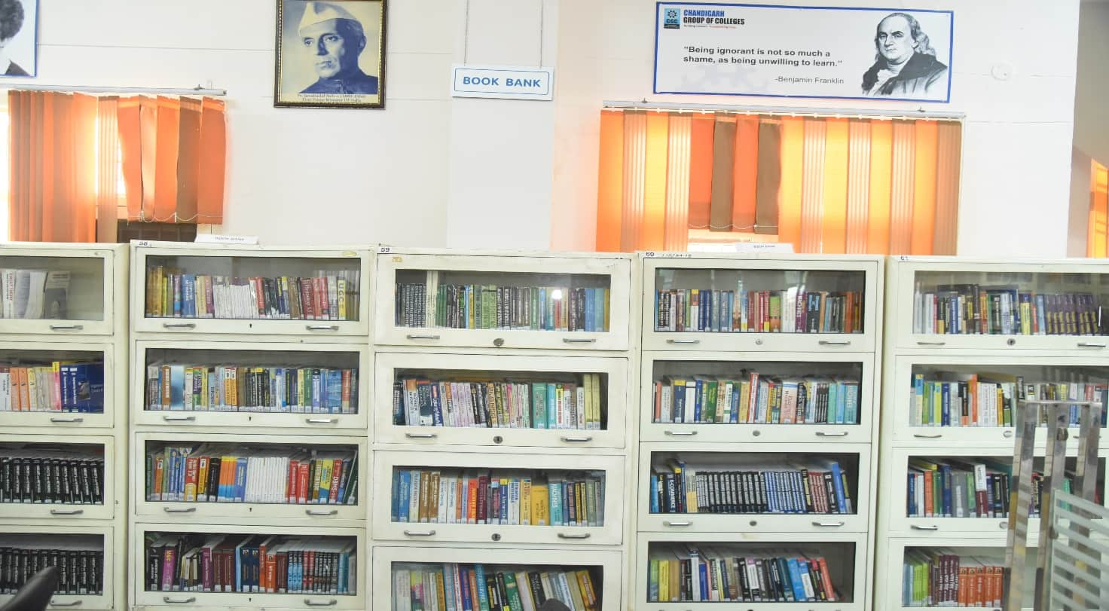
BOOK BANK SECTION

Slide 67
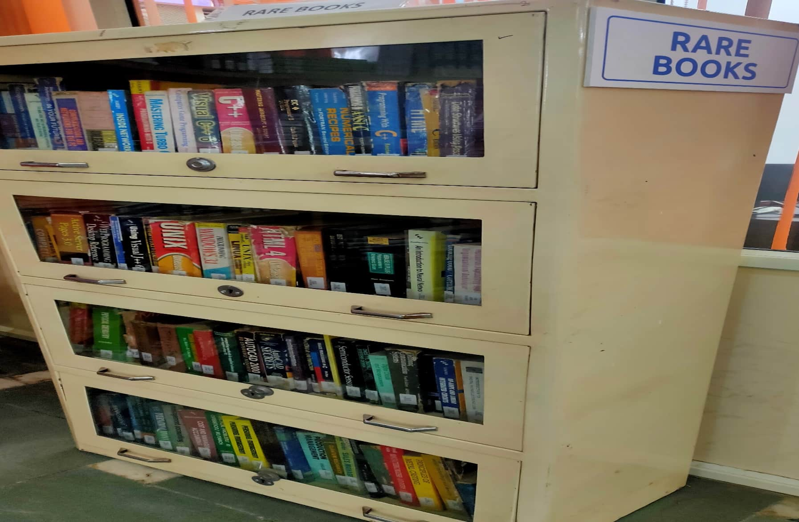
RARE BOOKS SECTION

Slide 68

PG COURSES BOOKS SECTION

Slide 69

STACK AREA

Slide 70

PERIODICAL SECTION
LIBRARIES SUBSCRIBES 89 PRINT JOURNALS, 21 MAGAZINES AND 21 NEWSPAPERS

Slide 71
LIST OF SUBSCRIBED PRINT JOURNALS
YEAR 2026
APPLIED SCIENCE
1 | GLOBAL JOURNAL OF PURE & APPLIED MATHEMATICS
2 | INTERNATIONAL JOURNAL OF PURE & APPLIED PHYSICS
3 | INTERNATIONAL JOURNAL OF APPLIED CHEMISTRY
ECE
4 | INTERNATIONAL JOURNAL OF ELECTRONICS & COMMUNICATION ENGG.
5 | INTERNATIONAL JOURNAL OF MOBILE COMMUNICATION & NETWORKING
6 | INTERNATIONAL JOURNAL OF ELECTRONIC NETWORK,DEVICES & FIELDS
7 | ADVANCES IN WIRELESS & MOBILE COMMUNICATION
8 | INDIAN JOURNAL OF DIGITAL ELECTRONIC TECHNOLOGIES
CSE & IT
9 | INTERNATIONAL JOURNAL OF ADVANCED SOFTWARE ENGINEERING
10 | INTERNATIONAL JOURNAL OF DATA MINING & DATA WAREHOUSE
11 | INTERNATIONAL JOURNAL OF COMPUTER & INTERNET SECURITY
12 | INTERNATIONAL JOURNAL OF COMPUTATIONAL INTELLIGENT RESEARCH
13 | INDIAN JOURNAL OF DIGITAL INFORMATION TECHNOLOGY
14 | JOURNAL OF COMPUTER SCIENCE ENGINEERING & SOFTWARE TESTING
15 | JOURNAL OF COMPUTER BASED PARALLEL PROGRAMMING
16 | INVENTI IMPACT COMPTER NETWORKS & COMMUNICATIONS

Slide 72
17 | INVENTI IMPACT:CLOUD COMPUTING
ME
18 | JOURNAL OF MECHANICAL & MECHANICS ENGINEERING
19 | JOURNAL OF ENVIRONMENT ENGINEERING & STUDIES
20 | INVENTI IMPACT MECHANICAL ENGINEERING
MBA/M.COM/BBA/B.COM
21 | INTERNATIONAL JOURNAL OF MARKET RESEARCH & MARKET TECHNOLOGY
22 | INTERNATIONAL JOURNAL OF BUSINESS ADMINISTRATION & MANAGEMENT
23 | INTERNATIONAL REVIEW OF BUSINESS & FINANCE
24 | INTERNATIONAL JOURNAL OF CUSTOMER RELATION MANAGEMENT
25 | INTERNATIONAL JOURNAL OF HUMAN RESOURCE MANAGEMENT
26 | IUPJOURNAL OF BANK MANAGMENT
27 | JOURNAL OF DIGITAL MARKETING
28 | IUP JOURNAL OF OPERATIONAL MANAGEMENT
29 | IUP JOURNAL OF ORGANIZATIONAL BEHAVIOR
30 | SCIENXT INTERNATIONAL JOURNAL OF RECENT TRENDS IN DIGITAL MARKETING
31 | GLOBAL JOURNAL OF FINANCE & MANAGEMENT
MCA/BCA
32 | JOURNAL OF COMPUTER SCIENCE & APPLICATIONS
33 | INTERNATIONAL JOURNAL OF ADVANCED COMPUTER SCIENCE & TECHNOLOGY
34 | GLOBAL JOURNAL OF COMPUTATIONAL INTELLIGENCE RESEARCH
35 | JOURNAL OF INNOVATIONS IN DIGITAL MARKETING
36 | INDIAN JOURNAL OF COMPUTER SCIENCE :THEORY & PRACTICAL
37 | INVENTI IMPACT:SOFT COMPUTING

Slide 73
DATA SCIENCE
38 | JOURNAL OF BIG DATA TECHNOLOGY & BUSINESS ANALYTICS
39 | JOURNAL OF INNOVATIONS IN DATA SCIENCE & BIG DATA MANAGEMENT
40 | JOURNAL OF INTEGRATED MARKETING COMMUNICATIONS & DIGITAL MARKETING
41 | JOURNAL OF INTELLIGENT DATA ANALYSIS & COMPUTATIONAL STATISTICS
42 | INTERNATIONAL JOURNAL OF DATA SCIENCE & MANGEMENT
CS-IOT
43 | JOURNAL OF INTERNET OF THINGS
44 | ADVANCEMENT OF IOT IN BLOCKCHAIN TECHNOLOGY & ITS APPLICATIONS
45 | JOURNAL OF IOT BASED DISTRIBUTED SENSOR NETWORKS
46 | JOURNAL OF SENSOR & CLOUD COMPUTING
47 | JOURNAL OF FUTURE INTERNET & HYPERCONNECTIVITY
CYBER SECURITY
48 | JOURNAL OF CYBER SECURITY IN COMPUTER SYSTEM
49 | JOURNAL OF CYBER SECURITY,PRIVACY ISSUES & CHALLENGES
50 | JOURNAL OF HACKING TECHNIQUES ,DIGITAL CRIME PREVENTION & COMPUTER VIROLOGY
51 | JOURNAL OF CRYPTOGRAPHY & NETWORK SECURITY,DESIGN & CODES
52 | INTERNATIONAL JOURNAL OF CYBER SECURITY
CGC-COE
53 | JOURNAL OF ANDROID AND IOS APPLICATIONS AND TESTING
54 | JOURNAL OF NEW TRENDS IN ROBOTICS & AUTOMATION
55 | JOURNAL OF INFORMATION TECHNOLOGY AND SCIENCES
56 | ICTACT JOURNAL ON COMMUNICATION TECHNOLOGY
57 | INVENTI IMPACT ENGINEERING MATHEMATICS
58 | JOURNAL OF WEB DEVELOPMENT AND WEB DESIGNING

Slide 74
ARTIFICIAL INTELLIGENCE & ML
59 | ICTACT JOURNAL ON DATA SCIENCE & MACHINE LEARNING
60 | INVENTI IMPACT :ARTIFICIAL INTELLIGENCE
61 | RECENT TRENDS IN ARTIFICIAL INTELLIGENCE AND ITS APPLICATIONS
62 | JOURNAL OFARTIFICIAL INTELLIGENCE RESEARCH & ADVANCES
63 | RESEARCH & REVIEW :MACHINE LEARNING & CLOUD COMPUTING
64 | JOURNAL OF FUZZY SETS & FUZZY LOGIC DESIGN
HOSPITALITY
65 | INTERNATIONAL JOURNAL OF TOURISM AND HOTEL MANAGEMENT
66 | INTERNATIONAL JOURNAL OF HOSPITALITY & TOURISM SYSTEMS
67 | JOURNAL OF HOSPITALITY APPLICATION & RESEARCH
68 | ATITHYA : A JOURNAL OF HOSPITALITY
69 | JOURNAL OF CURRENT RESEARCH IN FOOD SCIENCE
PHARMACY
70 | INVENTI IMPACT-ADVANCED DOSAGING
71 | INVENTI IMPACT-BIOMEDICAL ANALYSIS
72 | INVENTI IMPACT-CLINICAL RESEARCH
73 | INVENTI IMPACT-GENE MEDICINES
74 | INVENTI IMPACT-MED-CHEM
75 | INVENTI IMPACT-PHARM ANALYSIS & QUALITY ASSURANCE
76 | INVENTI IMPACT-PHARM BIOTECH & MICROBIO
77 | INVENTI IMPACT-PHARMACOKINETICS & PHARMACODYNAMICS
78 | INVENTI IMPACT- PHARMACY PRACTICE
79 | INVENTI IMPACT-PHARM TECH
80 | INTERNATIONAL JOURNAL OF DRUG REGULATORY AFFAIRS

Slide 75

81 | INTERNATIONAL JOURNAL OF PHARMACY & DRUG RESEARCH
82 | GLOBAL JOURNAL OF PHARMACEUTICAL SCIENCES & EDUCATION
83 | INTERNATIONAL JOURNAL OF BIOMEDICAL & HEALTHCARE SCIENCES
84 | INTERNATIONAL JOURNAL OF APPLIED PHARMACEUTICS
BIOTECHNOLOGY
85 | INTERNATIONAL JOURNAL OF BIOTECHNOLOGY AND BIOCHEMISTRY
86 | ASIAN JOURNAL OF MICROBIOLOGY, BIOTECHNOLOGY AND ENVIRONMENTAL SCIENCES
87 | JOURNAL OF CANCER RESEARCH & THERAPEUTICS
88 | SCIENXT JOURNAL OF BIOTECHNOLOGY & LIFE SCIENCES
89 | SCIENXT JOURNAL OF MICROBIOLOGY

Slide 76

BOUND VOLUMES SECTION
JOURNALS 2003-2024

Slide 77


ENGLISH NEWSPAPERS
1. The Tribune
2. Hindustan Times
3. The Times of India
4. Indian Express
5. The Hindu
6. The Financial Express
7. Business Standard
8. Economic Times
9. Economic Times Wealth
HINDI NEWSPAPERS
10. Punjab Kesari
11. Dainik Bhaskar
12. Amar Ujala
13 Dainik Savera
14. Ajit Samachar
14. Divya Himachal5
16. Hindi Tribune
PUNJABI NEWSPAPERS
17. Jagbani
18. Punjabi Jagran
19. Ajit
20. Punjabi Tribune
21. Rozana Spokesman

Slide 78

LIST OF MAGAZINES
INDIA TODAY (ENG.)
INDIA TODAY ( HINDI)
PC QUEST
BUSINESS TODAY
BUSINESS WORLD
DIGIT
COMPETITION SUCCESS REVIEW
FRONTLINE
SCIENCE REPORTER
TRAVEL AND LEISURE

Slide 79
LIST OF MAGAZINES CONTD.
AUTOCAR
OUTLOOK
PRATIYOGITA DARPAN
YOJNA
THE WEEK
EMPLOYMENT NEWS
GOOD HOMES
ELECTRONICS FOR YOU
LINUX FOR YOU
HAPPIEST HEALTH
OUTLOOK TRAVELLER

Slide 80




Slide 81




Slide 82

FOR ANY QUERY / SUGGESTION CONTACT :
Renu Oberoi
Chief Librarian
Chandigarh Group Of Colleges- Landran
0172-3984229
8872014309
chief.librarian@cgc.edu.in
FOR SUGGESTIONS

Slide 83

Ready to HELP YOU.
THANK YOU

Slide 84

FOR DIGITAL COPY OF PPT

